Slide 1
OMS Soccer Meeting
September 5, 2023

Slide 2
Agenda
Introductions
Coaching Philosophy
Team Expectations
Health & Safety
Family Support
Communication
“Success is no accident. It is hard work, perseverance, learning, studying, sacrifice and most of all, love of what you are doing or learning to do.” – Pelé

Slide 3
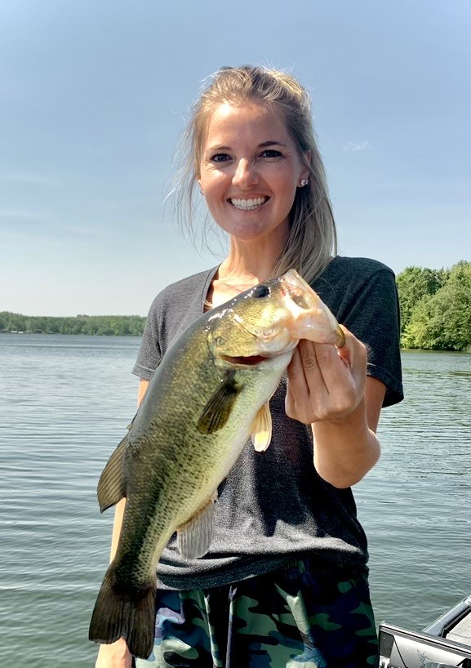
Introductions
Coach McDonald
Coach Clark
“Success is no accident. It is hard work, perseverance, learning, studying, sacrifice and most of all, love of what you are doing or learning to do.” – Pelé

Slide 4
Coaching Philosophy
Conditioning
Healthy Lifestyle
Academic Performance
Respect
Growth Mindset
Excellence as habit
Relationships
Sportsmanship
“Success is no accident. It is hard work, perseverance, learning, studying, sacrifice and most of all, love of what you are doing or learning to do.” – Pelé

Slide 5
Coaching Philosophy
Conditioning – build strength, develop endurance and increase power throughout the season
Healthy Lifestyle – sleep in cool environment with no technology, eating carbohydrates/protein, and hydrate
Academic Performance – prioritize classes, maintain A’s and B’s, use Fridays for tutoring and make-up work
Respect – hold your teammates, coaches, and the game in high regard throughout the year
“Success is no accident. It is hard work, perseverance, learning, studying, sacrifice and most of all, love of what you are doing or learning to do.” – Pelé

Slide 6
Coaching Philosophy
Growth Mindset – believe that talent is ever growing, embrace feedback, and view challenges as opportunities
Excellence (as habit) – treat practice and games the same, allow repetition to build habit, and consider your goals
Relationships – get to know your team, encourage each other on and off the field and focus on teamwork
Sportsmanship – “win with class, lose with dignity,” shake hands with opposing players, respect the sport
“Success is no accident. It is hard work, perseverance, learning, studying, sacrifice and most of all, love of what you are doing or learning to do.” – Pelé

Slide 7
Rules & Expectations
General
Eligibility
Per school policy, students must maintain a minimum of a C average to remain eligible to play on the team
Students absent from school, recovering from illness, or suspected of having a concussion cannot play in practice or games
Philosophy
Players are expected to follow our “chargers” philosophy throughout the season
Players are student-athletes (academics comes first!)
Captains
Our team will have two captains chosen by the players & coaches
They will be responsible for leading stretching, cleaning up after practice, serving as role models, and the coin toss in games
“Success is no accident. It is hard work, perseverance, learning, studying, sacrifice and most of all, love of what you are doing or learning to do.” – Pelé

Slide 8
Rules & Expectations
Practices
Athletes will drop off their belongings by the locker room, change, and have a snack (we will walk to the field at 3:40).
Players are expected to be at every practice (unless they are sick and absent from school)
Students late to practice will be expected to have a pass from a teacher (let coach know before practice happens)
Practice will be held Monday through Thursdays from 3:30-5:30pm (Fridays should be used for academic support and individual conditioning)
Students are expected to have a water bottle with their name on it (many water breaks throughout practices)
“Success is no accident. It is hard work, perseverance, learning, studying, sacrifice and most of all, love of what you are doing or learning to do.” – Pelé

Slide 9
Rules & Expectations
Games
Games will be on Tuesdays and Thursdays (schedule distributed)
The playing time an athlete receives is a privilege, not a right; playing time is earned in practice and is not an entitlement.
Players are expected to ride the bus to and from away games when required (you can meet them back at the school)
Athletes suspected of a concussion or injury will be pulled from the rest of the game
Booster Club Members and/or team parents will need to assist with the concession stand during home games (more information coming)
Tickets to games are $5 cash or $6 GoFan (digital ticket)
“Success is no accident. It is hard work, perseverance, learning, studying, sacrifice and most of all, love of what you are doing or learning to do.” – Pelé

Slide 10
Rules & Expectations
Code of Conduct
Student athletes, and their families, are expected to be aware of and follow the OCS Athletics Handbook.
Violations of the rules, team philosophy, and/or coaches' expectations will result in suspension from practice, games, and/or team events.
The following violations will result in immediate dismissal from the team:
Hazing - Annoying any student by playing abusive or ridiculous tricks on him, to frighten, scold, beat or harass him or to subject him to personal indignity) or to aid or abet any other student in hazing
Illegal Substances - Any student-athletes found in possession of or known to have used any illegal substances or performance enhancing drugs
ISS/OSS – Any athlete who has three days of either in-school or out-of-school suspension will be removed from the team
“Success is no accident. It is hard work, perseverance, learning, studying, sacrifice and most of all, love of what you are doing or learning to do.” – Pelé

Slide 11
Health & Safety
Health
Hydration, Hydration, Hydration
“Healthy Lifestyle” - philosophy
Talk with coaches about any concerns
Safety
Inherent risk in any sport
Concussion Protocols
Emergency Plan
“Success is no accident. It is hard work, perseverance, learning, studying, sacrifice and most of all, love of what you are doing or learning to do.” – Pelé

Slide 12
Family Support
Support Our Team
Support our “Charger” philosophy at home!
Pick up your athlete, on time, after practice (no later than 5:45pm) in the side parking lot
Attend games and cheer for our team!
Volunteer to work concessions through your participation in the Orange Middle School Booster Club!
Consider donating to the team through the school – we will not be having any fundraisers this year
“Success is no accident. It is hard work, perseverance, learning, studying, sacrifice and most of all, love of what you are doing or learning to do.” – Pelé

Slide 13
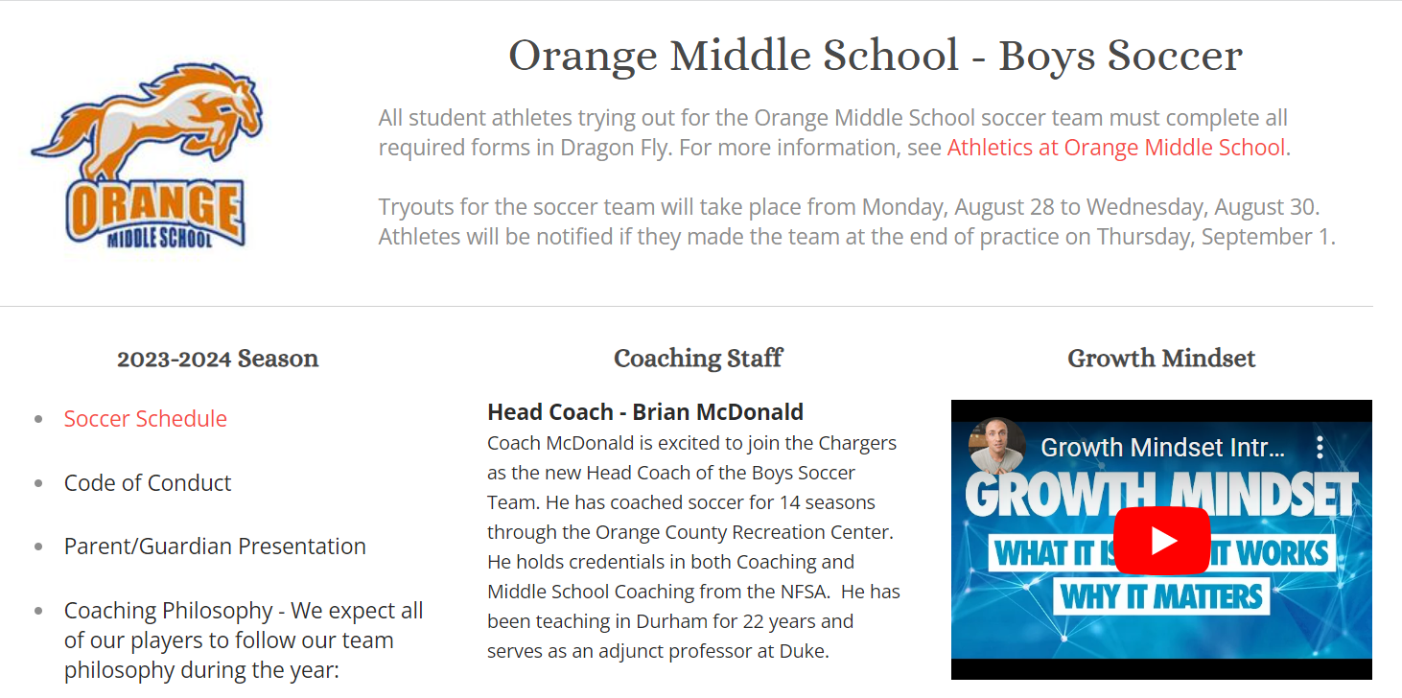
Communication
REMIND Text @lucyclar to 81010 and wait for approval
OMS Soccer Website (http://learningandunlearning.weebly.com/oms-soccer.html)
“Success is no accident. It is hard work, perseverance, learning, studying, sacrifice and most of all, love of what you are doing or learning to do.” – Pelé
EMAIL
An email list will be created based on the email you left on the sign-in sheet tonight
REACH OUT
Talk with Coach McDonald or Coach Clark after practice if they are available

Slide 14
Questions
“Success is no accident. It is hard work, perseverance, learning, studying, sacrifice and most of all, love of what you are doing or learning to do.” – Pelé

