Slide 1
“A Marathon, Not a Sprint”
Practices and Perspective
Brian McDonald
Duke University
March 12, 2018

Slide 2
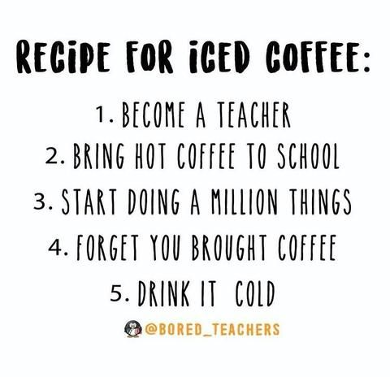
AGENDA
Overview
T.e.a.c.h.e.r.
Time
Enthusiasm
Advocacy
Craft
Home
Experiences
Reflection
Ask Me Anything

Slide 3
TIME
Consider these questions:
How can you save your time?
How can you protect your time?
How do you prioritize your time?
How can you set limits?
Strategies
Create a schedule and post it!
Avoid lunch unless…
Just say no to Fridays
Use technology!

Slide 4
ENTHUSIASM
Build Relationships
Get to know your students – student survey
Celebrate good news – from them, about them
Talk to every student, every class period
Every kid needs a champion
“Every child deserves a champion – an adult who will never give up on them, who understands the power of connection and insists that they become the best that they can possibly be.”

Slide 5
ADVOCACY
For yourself ---
Observations
Your schedule
The process: “Get involved in changing the process. When we see concerns or problems that affect us, we might have some solutions or suggestions. Collaborate with someone on a way to tackle the situation.”
For your students ---
“Teach to the Top” with High Expectations
Avoid becoming a High School Training Ground
Work with intervention teams – athletics, EC, parents

Slide 6
CRAFT
Instructional Presentation
Classroom Management
Assessment

Slide 7
CRAFT – Instructional Presentation
5 Highly Effective Teaching Strategies (Edutopia)
Teacher Clarity: purpose, goals, criteria, models, examples
Classroom Discussion: students learning from each other
Feedback: individual vs. whole group feedback, adjustments
Formative assessments: assess frequently
Metacognitive strategies: students can plan, organize, monitor, direct and self-reflect
14 Minutes

Slide 8
CRAFT – Instructional Presentation
Learning Statistics – We Learn:
10% of what we read
20% of what we see
30% of what we hear
50% of what we see and hear
70% of what we discuss with others
80% of what we experience
95% of what we teach to someone else

Slide 9
CRAFT – Classroom Management
Content
Unit Plans
Bell to Bell instruction
Group Work
Assign groups
Specific expectations
Logistics
Seating charts
Directions: Power of 3
Organization
Daily agenda
Create systems
Time Management
Use a Timer (14)
Multi-tasking
Behavior
Know/Enforce the rules
Hold them accountable

Slide 10
CRAFT – Classroom Management

Slide 11
CRAFT – Grading
Questions
How do you assess your students?
How many grades do you have per quarter?
How do you include authentic assessment?
“The most effective grading practices provide accurate, specific, timely feedback designed to improve student performance” (Marzano 2000, 2007; O'Connor, 2007).
Strategies: 7 Best Practices

Slide 12
CRAFT – Grading
Provide useful feedback (to them and for you)
Have students self-grade
Create and discuss/review rubrics
Extra Credit?
No curve, but scale it!
Go over the most frequently missed questions
Tiered grading:
Tier 1 – Grade all of it (tests, quizzes, papers, projects)
Tier 2 – Grade some of it (homework, classwork, additional assignments)
Tier 3 – Grade none of it (full participation for completion)

Slide 13
HOME

Slide 14
HOME
Expert Advice:
“Take a moment and breathe.”
“Stepping away is critical. Do something fun. Enjoy yourself even for an afternoon or evening.”
“Cut yourself off from school work once you go home. It might be hard, but for your mental sanity it’s well worth it! This includes not coming in to school on the weekends if you can help it.”

Slide 15
EXPERIENCE
Experience = Perspective
This Is Water
Marathon, Not a Sprint
“My student-teaching mentor told me that I couldn’t decide about teaching as a career until after Year 3. Year 1 is pure hell Year 2 is at least 50% easier. And Year 3 you start to find a comfort level.”
Mentoring
What Teachers Make

Slide 16
EXPERIENCE
Today was the absolute worst day ever And don’t try to convince me that There’s something good in every day Because, when you take a closer look, This world is a pretty evil place Even if Some goodness does shine through once in a while Satisfaction and happiness don’t last. And it’s not true that It’s all I the mind and heart Because True happiness can be obtained Only if one’s surroundings are good It’s not true that good exists I’m sure you can agree that The reality Creates My attitude It’s all beyond my control And you’ll never in a million years hear me say that Today was a good day

Slide 17
REFLECTION
The Most Important Question, Revisited
How do you reflect and re-evaluate?
Five Year Plan
Moment of the Day
Journaling Your Experiences
How can you make the investment?
How can you accomplish what you want to do?
How can you be fulfilled?
The Time You Have (In Jellybeans)

Slide 18
CONCLUSION

