Slide 1
Not the end, but the beginning

Slide 2
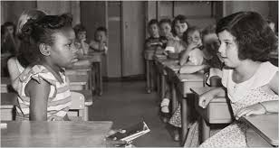
From topeka to durham
The Brown Decision, Change Deferred, and a “Separate, But Equal” Approach, 1954-1963

Slide 3
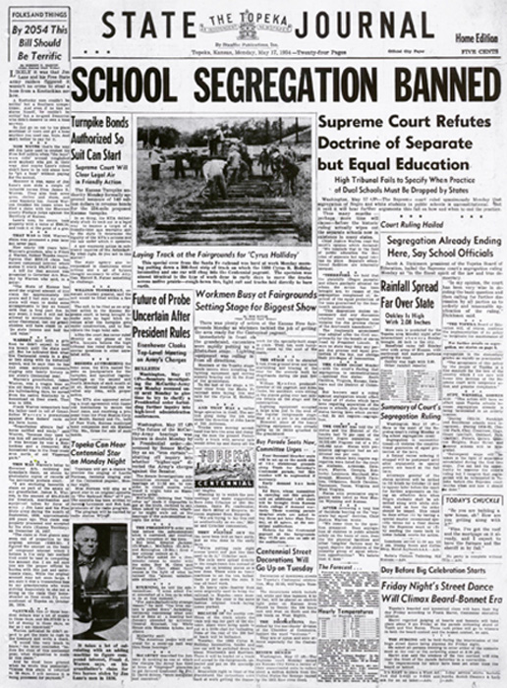
FROM TOPEKA TO DURHAM
NATIONAL PERSPECTIVE
We conclude that in the field of public education the doctrine of “separate but equal” has no place. Separate education facilities are inherently unequal. Therefore, we hold the plaintiffs…. deprived of the equal protection of the laws guaranteed by the Fourteenth Amendment.

Slide 4
THE REACTION IN DURHAM
Durham School Board member Ruth Dailey noted, shortly after the Brown decision, that Durham would certainly respond, but would not “rush out and do everything the next week in terms of compliance.”

Slide 5
Tuesday – August 13, 1957

Slide 6
THE REACTION IN NORTH CAROLINA
Pupil Assignment Law (1957) – Also known as the Pearsall Plan, “each local school board was given the authority to review and decide, each on its individual merits other than race, applications for reassignment in the public schools.”
Schools would remain segregated, unless challenged.

Slide 7
WHAT HAPPENS BETWEEN 1957 & 1963?
“3rd Negro Student at Durham High School” --Sept. 18, 1959
“City School Board Refuses Further School Integration”
–Sept .22, 1959
“200 Negroes File for White School” --Aug. 21, 1960
“7 Mere Negroes in White Schools” --Sept. 5, 1960
“135 Negroes Seek Change in Schools” --June 14, 1961
“Few Negroes Seen in White Schools” --July 14, 1962

Slide 8
WHAT HAPPENS BETWEEN 1957 & 1963?
“20 Negroes Seen in White Schools” -- July 17, 1962
“42 Negroes Enrolled in White Schools” -- Sept. 6, 1962
“City School Integration Plan Given”-- Aug. 20, 1963
“60 Negroes Reassigned to Predominantly White Schools”
--May 31, 1963
“Negroes Defy Sanford Plea to Cease Demonstrations”-- 6.26.63
“Freedom of Choice” given to parents -- Aug. 20, 1963

Slide 9
RESISTANCE and RESPONSE:
The “North Carolina Way”
Pupil Assignment Act/Pearsall Plan: Control of public education turned over to local school districts
Transfer Requests/Denied: A vs. C
Freedom of Choice: Policy vs. Practice
Tokenism: In 1966 only 6 percent of its black children were actually attending schools with whites
(Not so) Passive Resistance: “Fail every negro student”
State Government Opposition: “Resist the highest court…defy the Constitution”

Slide 10
SEGREGATION:
STATISTICALLY SPEAKING…
By 1963, “99.6 percent of Negroes in all the school districts of the eleven [Southern] states are still attending all-Negro Schools.”
– The Carolina Times
“At the beginning of 1963, nine years after the historic decision, approximately 9 per cent of southern Negro students were attending integrated schools. If this pace were maintained, it would be the year 2054 before integration in southern schools would be a reality.”
– Martin Luther King

Slide 11
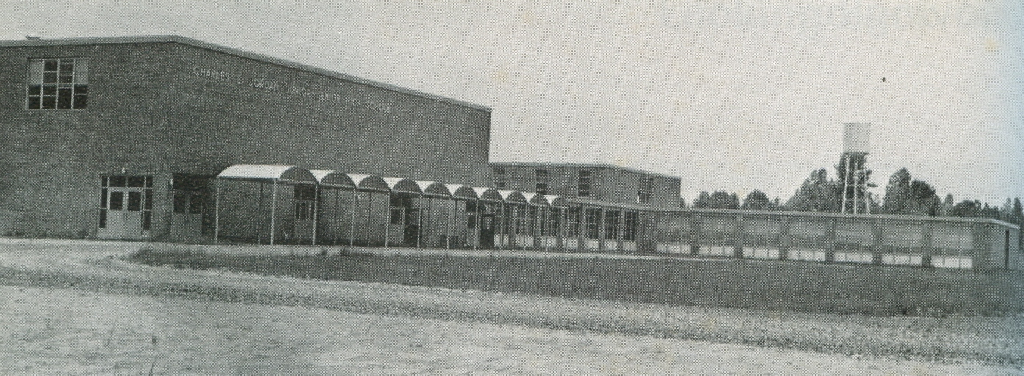
The opening of C.E. jordan high school
“The White Man’s Ice,” 1963-1969

Slide 12
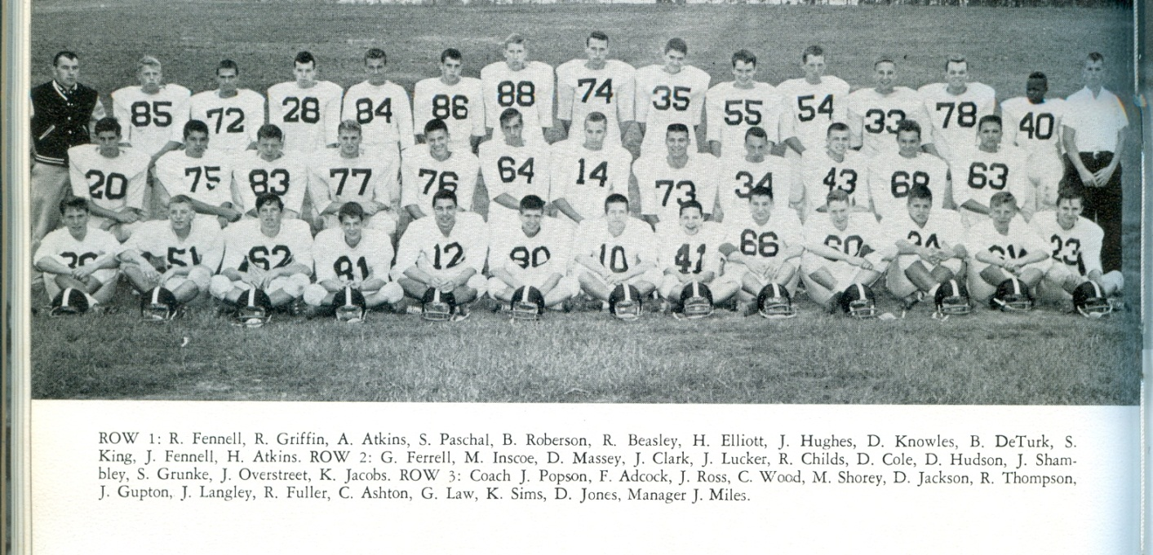
SCHOOL OPENS
In the same year that a federal court rejects the too gradual desegregation for a “freedom-of-choice” plan, Charles E. Jordan opens in September of 1963 with approximately 500 students.

Slide 13
July 3, 1964
One year after the school opens, and ten years after the Brown decision, only 9 black students attend Jordan High School

Slide 14
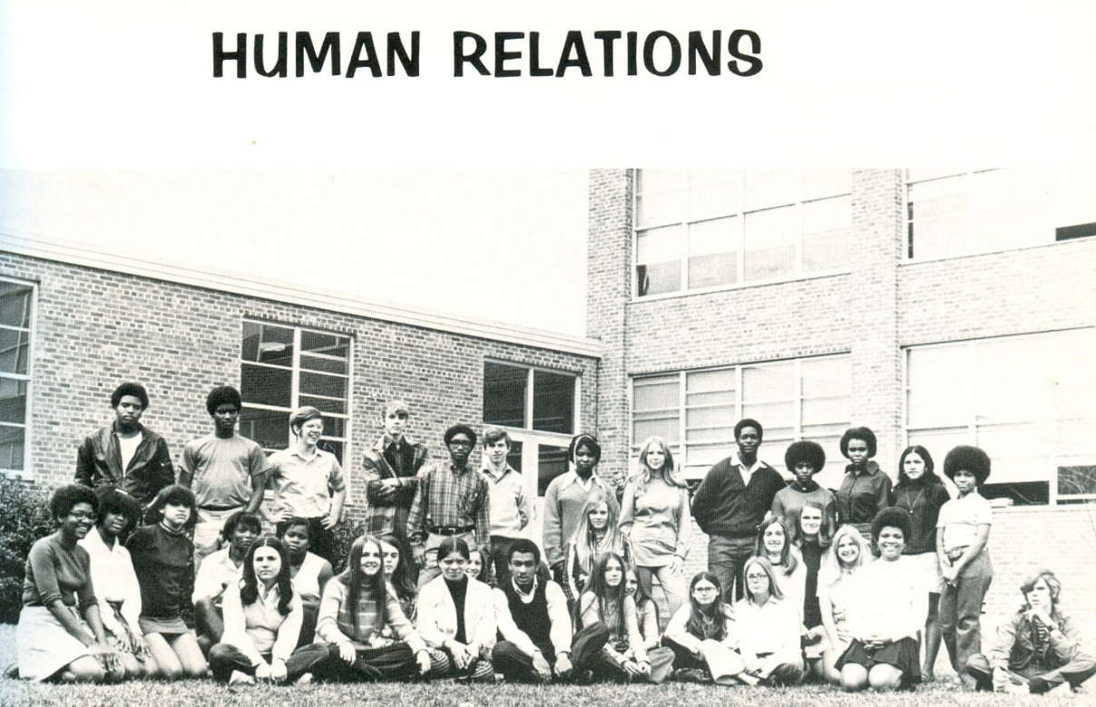
The first merger
Transition, Tension, and a Transformation in “a new and strange land,” 1969-1976

Slide 15
JHS Transformation: “It’s a requirement that we assimilate. It’s not a requirement that they adjust to us”
1969 – Homecoming Court Challenged
1970 – Teacher stabbed in hallway
1972 – Jordan Cheerleaders Attacked
1973 – Basketball Game Played in empty gym
1974 – African Dance Group Demonstration,
Black Humanities course created
OSIBA organized,
Charles Guess arrives at Jordan
1975 – Courtyard/Smoking Area Demonstration
1976 – Front Lobby Sit-In

Slide 16
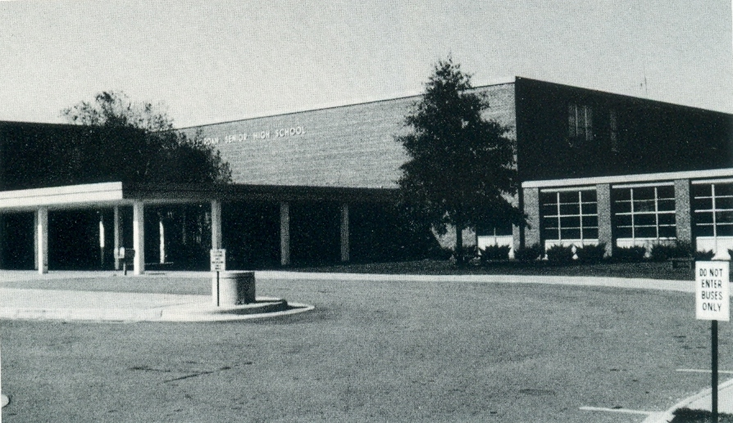
Equal but separate
Conclusions and Observations: The Second Merger and the Emergence of “Two Schools,” Jordan Since 1988

Slide 17
CONCLUSIONS & OBSERVATIONS
The “North Carolina Way” allowed for a complicated response to federal integration orders
Not the hotbed of racial conflict like other parts of the American South, but faced a significant transformation
Faced another transformation when Durham City Schools and Durham County Schools merge in 1992
Guarded coexistence among students, self-segregation within our community, and “two schools” in one

Slide 18

Learning from the past
Historical Lessons and Present Day Implications

Slide 19
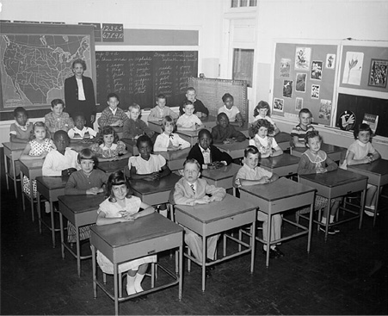
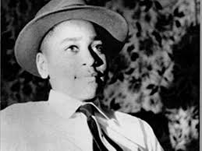
60 years ago…

Slide 20
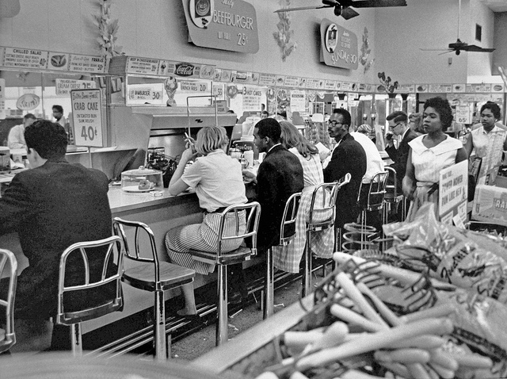
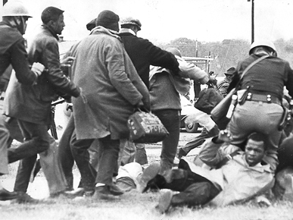
50 years ago…

Slide 21
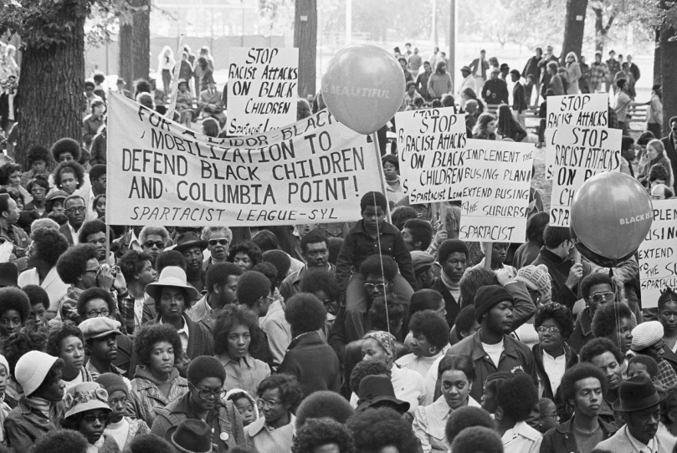
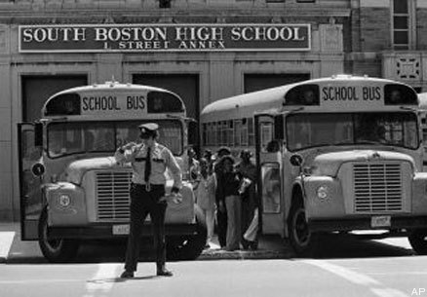
40 years ago…
45.1%

Slide 22
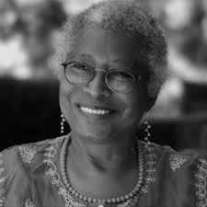
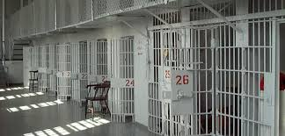
30 years ago…

Slide 23
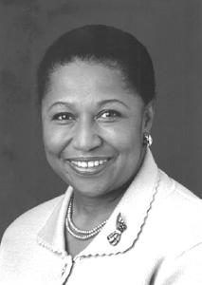
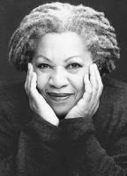
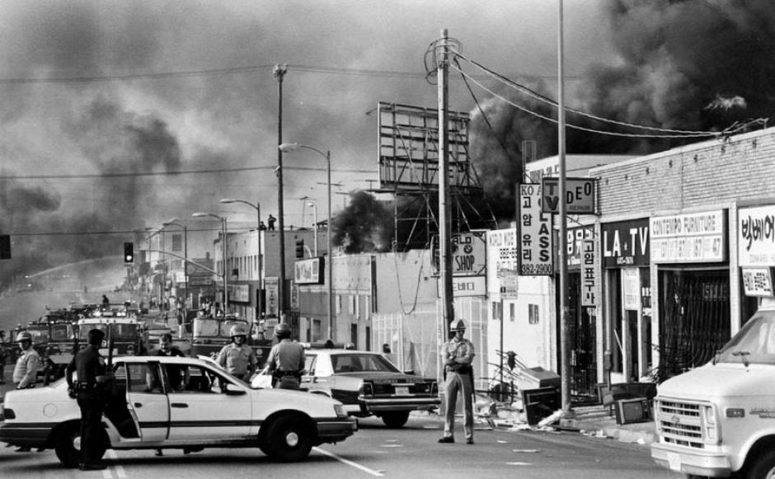
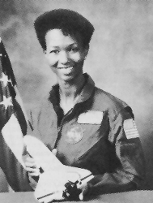
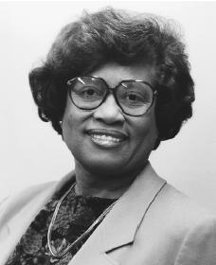
20 years ago…

Slide 24
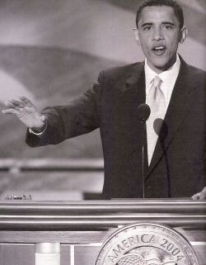

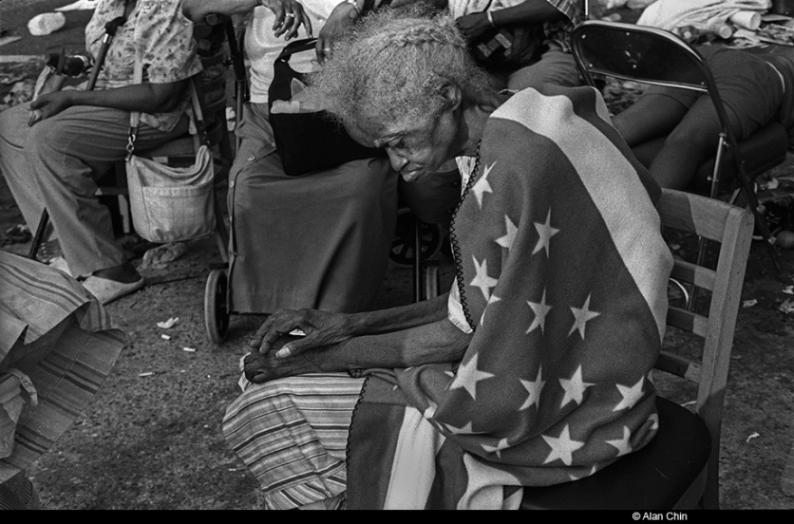
10 years ago…

Slide 25

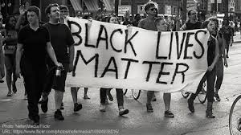
Today…

Slide 26
Tomorrow?

