Slide 1
ARAB AMERICAN EXPERIENCE

Slide 2
OVERVIEW
Definition of an Arab American/Muslim
History & Immigration
Arab American Demographics
Culture: Values, Perception, & Gender
Religion: How is it different?
Sources of Anti-Arab sentiment in the U.S.
Contemporary Arab American Issues

Slide 3
DEFINITION
ARAB AMERICAN is the term given to persons
who immigrated to the United States from a group
of independent nation-states in North Africa and the
Middle East.
They have a common cultural heritage that has been
shaped primarily by the religions of Islam and
Christianity.

Slide 4
DEFINITION
Westerners often confuse the terms Arab American and Muslim American
Arabs are an ethnic group and Muslims are a religious group (Islam is the faith)
Many Arabs are not Muslims, and most Muslims are not Arabs

Slide 5
ARAB AMERICAN IMMIGRATION
Early Immigration (1886-1914)
Between World War I and World War II (1915-1945)
The later immigration period

Slide 6
EARLY IMMIGRATION PERIOD (1886-1914)
A majority of Arab immigrants came from greater Syria, Lebanon, Palestine, Jordan, and occasionally Iraq.
Reasons for immigration included
Religious freedom
War/Conflict
Missionary activity
Most of these immigrants were poor, uneducated, and looking for new opportunities.
Opposed indoor factory work and chose door to door peddling
Eventually many opened MOM and POP type stores.

Slide 7
BETWEEN WWI AND WWII (1915-1945)
During this period, The United States Congress passed legislation that restricted immigration. These laws had an effect of slowing the movement of Arab Americans into the country

Slide 8
THE LATER IMMIGRATION PERIOD (1946 -)
Most of these Arab immigrants came from Egypt, Iran, and Palestine .
Reason - to study in our universities and many decided to stay
Most of these immigrants were largely educated, professional, and of the Muslim faith.
More of this group has been able to retain more of their culture and religion unlike the earlier immigrants.
Assimilation
While the earlier immigrants found it “easier” and “desirable” to assimilate into the American mainstream, the newer arrivals seem more prone to retain their Arab culture.
Why?

Slide 9
DEMOGRAPHICS
Population
Over 3 million, some estimate nearly 5 million
Religious Affiliation
majority (70%) have a Christian affiliation
Muslim/Islamic affiliation (30%)
Geographic Distribution
the area’s where the majority have settled includes:
New York, Los Angeles, San Francisco, Detroit, Washington DC, Houston, Chicago, and Jacksonville

Slide 10
Culture: Values & Beliefs
Basic Arab Values:
Dignity, Honor, and reputation are of paramount importance to an Arab. Typically an Arab will deport himself/herself in such a way as to create a good impression.
Loyalty to the family takes precedence over all personal needs
Piety (devotion to religion) is one of the most admirable characteristics.
There is no separation between church and state in many Arab Nations. Religion is taught in schools and promoted by the Government.
Religion is a way of life in both waves of immigration

Slide 11
Culture: Self-Perception
Arabs are generous, humanitarian, polite, and loyal.
Have a rich cultural heritage.
Clearly defined cultural group i.e., “Arab Nation”.
Have been victimized by the West.
Arabs are misunderstood in the West.

Slide 12
Culture: Gender Roles
Accuracy of statements concerning the relationship between men and women will vary based on the country discussed.
Saudi Arabia is the most conservative
As a general rule women interact freely only with other women and very close male relatives. Women and men are never alone together even for a short period of time
As a foreigner, if you are seen to be too familiar with someone of the opposite sex you will lose respect.

Slide 13
Culture: Gender Roles
The public display of intimacy between men and women is strictly forbidden by the Arab social code
This code also applies to husbands and wives
The maintenance of family honor is one of the highest values in Arab society.
In Arab cultures, misbehavior by women can do more damage to family honor than misbehavior by men

Slide 14
Culture: Women
Statements here vary in applicability depending on the country involved. For instance, in Lebanon, Jordan, and Egypt, educated women have been very active at all levels of society.
In the Persian Gulf States, most women do not work. Those who do, work only in all-female places such as schools and banks for women, except those in the medical profession
Typically, women's focus is in the house, but some changes in the work aspect are changing
Traditionally-oriented men and women don’t see prevailing customs as restrictive-rather as protection

Slide 15
Culture: Family
Family loyalty and obligation take precedence over loyalty to friends or the demand of a job
Family is seen as a persons ultimate refuge
In all cases, one must defend the honor of family members, even if you hate them or think they are wrong
Gender Roles: Arab men are the head of the household; women operates behind the scenes
Children are taught profound respect for adults

Slide 16
Culture: Family
Marriage
Many Arabs still prefer arranged marriages
This is done to keep dowry within the family
The family always plays a major role in the decision of any member to wed
Polygamy
is becoming rare
can be married to more than one women, but everyone is equal, no one gets anymore than the other
Divorce
Is very controlled, must pay substantially to the wife, must be asked three times in a public place w/witnesses

Slide 17
Islam:
Myths and Reality

Slide 18
Myth #1: Most Muslims are Arabs who live in the Middle East.
3

Slide 19
Reality:
Of more than 1 billion Muslims worldwide, only about 1/5 are Arabs.
4

Slide 20
Try to Guess:
Which country has more Muslims than any other country in the world?
5

Slide 21
Answer:
Indonesia - with over 200 million Muslims.
Note: The U.S. has about 5 million Muslims.
6

Slide 22
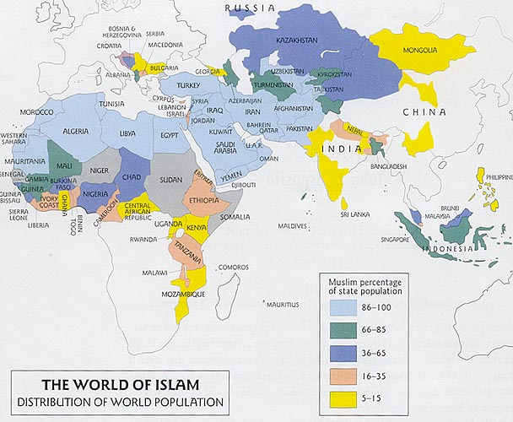
http://www.skidmore.edu/academics/arthistory/ah369/islam_map.jpg
7

Slide 23
Myth #2: Muslims have a strange religion and worship a god called Allah.
8

Slide 24
Reality:
Muslims are monotheistic and worship the same one God as Christians and Jews.
9

Slide 25
Note:
‘Allah’ is the Arabic word for ‘God.’
10

Slide 26
Myth #3:
Muslims believe it is o.k. to kill civilians in a holy war (“jihad”).
11

Slide 27
Reality:
Only Muslim extremists believe this. (Just like most Christians do NOT believe in bombing abortion clinics.)
12

Slide 28
Myth #4:
Most Muslim women wear veils over their faces and are treated very badly.
13

Slide 29
Reality:
Muslim women have many different styles of dress. (Very few cultures require women to cover their faces.)
The treatment of women varies from country to country and family to family.
Some Muslim countries, like Pakistan, have had female prime ministers. The U.S. has never had a female president.
14

Slide 30
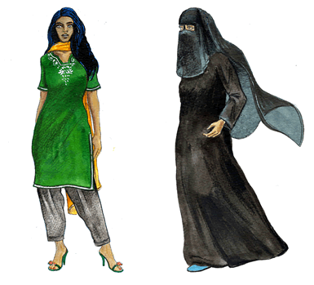
Pakistani dress (left); Saudi Arabian (right)
Shariah TV website
15

Slide 31
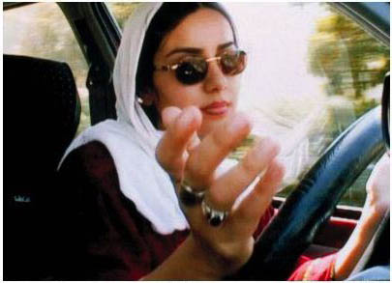
Iranian woman
Green Cine.com
16

Slide 32
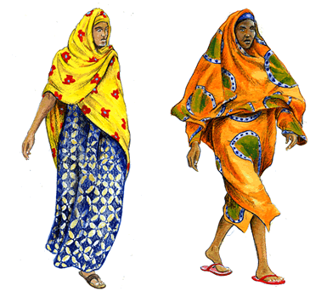
Somali (left); West African (right)
Shariah TV website
17

Slide 33
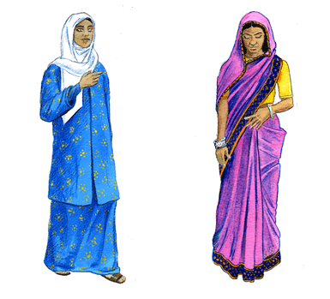
Malaysian (left); Indian/ Bangladeshi (right)
Shariah TV website
18

Slide 34
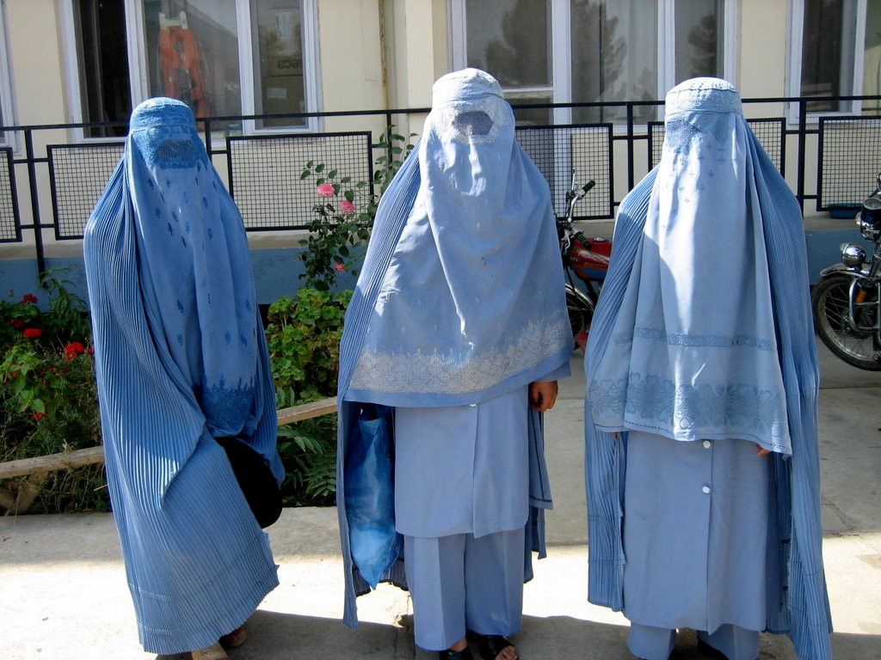
Afghani women wearing burqas
International Medical Corps photo
19

Slide 35
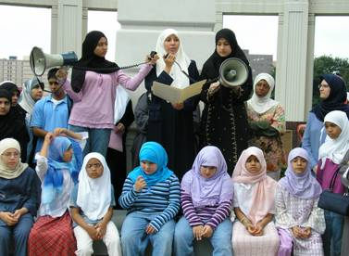
Muslim girls in Texas protesting discrimination for wearing head scarves
http://www.cairdfw.org
20

Slide 36
Something to think about:
Should women in a Western country be allowed to wear a headscarf if they choose?
21

Slide 37
Religion: Overview
Rituals characterize Islam
Example: Five pillars of Islam
Believers are divided into a variety of faiths and sects, such as the Sunnis and Shiites
Jihad: Struggle against the enemies of Allah, usually taken to mean one’s own internal struggle
What do Muslims believe in?

Slide 38
Religion
Muslims believe in:
In one unique, incomparable God
In the angels created by him and the prophets through whom his revelations were brought
In the day of judgement and individual accountability for actions
In Gods complete authority over human destiny and in life after death

Slide 39
Religion: Five Pillars
These are the five basic tenets of the Islamic faith
1. FAITH There is only one God and Mohammed is the messenger of God
2. PRAYER Prayer five times a day
3. THE ZAKAT Giving charity to poor 2.5% yearly
4. THE FAST Fasting during the month of Ramadan. Ramadan is the ninth month of the Islamic lunar calendar. During Ramadan, Moslems do not eat, drink, or smoke between sunrise and sunset. Purpose is to experience hunger and deprivation and to perform acts of self-discipline, humility, and faith
5. PILGRIMAGE to Mecca at least once during ones lifetime if it is not a financial hardship

Slide 40
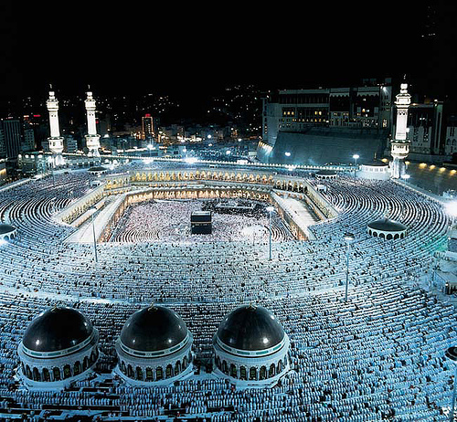
In Mecca during the pilgrimage
www.thefaithclub.com
28

Slide 41
Vocabulary:
MOSQUE: a Muslim place of worship
29

Slide 42
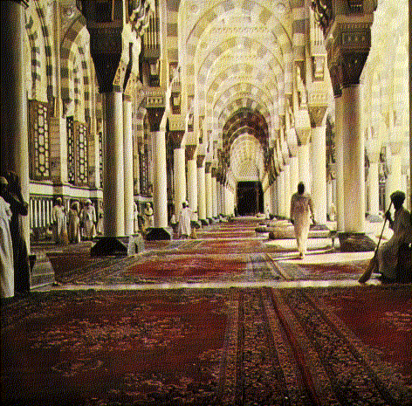
Mosque in Medina, Saudi Arabia
http://islamicbooks.info/H-21-Madh'habs
30

Slide 43
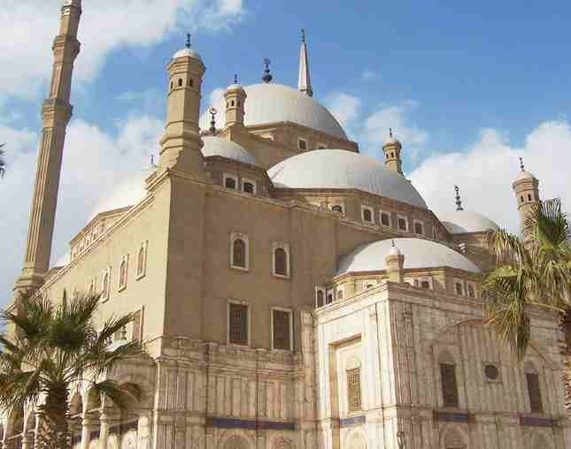
Mohammed Ali mosque, Cairo, Egypt
http://www.solarnavigator.net/geography/egypt.htm
31

Slide 44
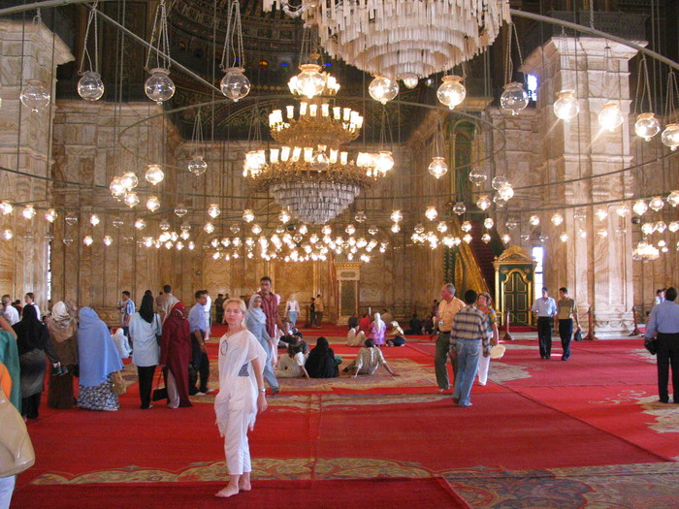
Inside the Mohammed Ali Mosque
http://www.ask-aladdin.com
32

Slide 45
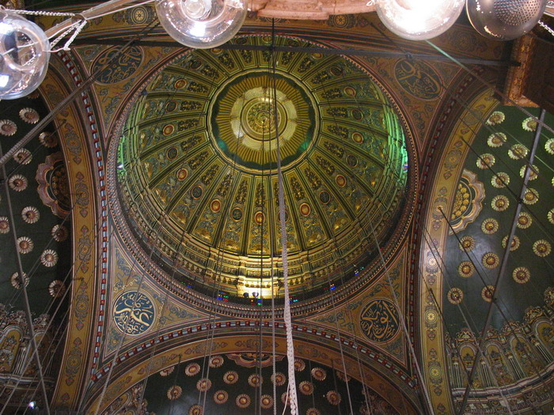
Dome of the Mohammed Ali mosque
http://www.ask-aladdin.com
33

Slide 46
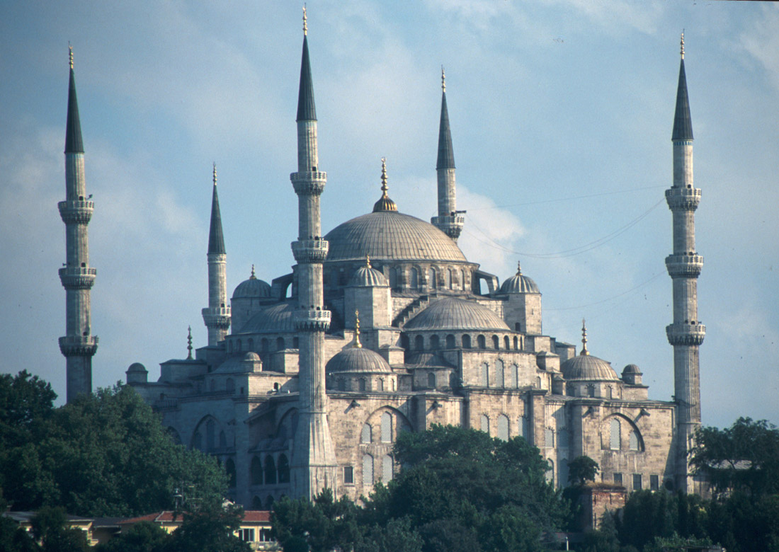
Blue Mosque (Sultan Ahmet Mosque), Istanbul Turkey
http://cs.ua.edu/~greg/personal.html
34

Slide 47
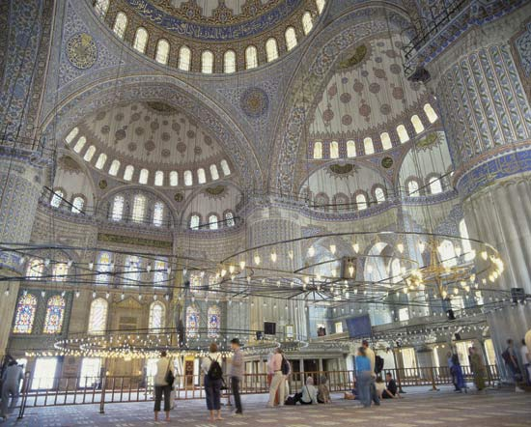
Interior of the Blue Mosque
http://www.britannica.com
35

Slide 48
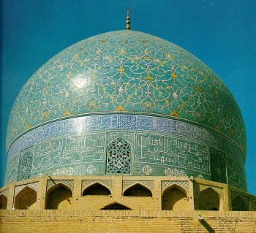
Dome of a mosque, Esfahan, Iran
http://www.perceptivetravel.com/issues/1106/maclean.html
36

Slide 49
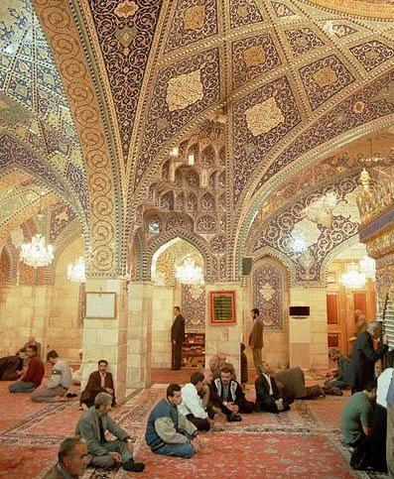
Interior of a mosque in Iran
http://www.worldisround.com/articles/73022/photo621.html
37

Slide 50
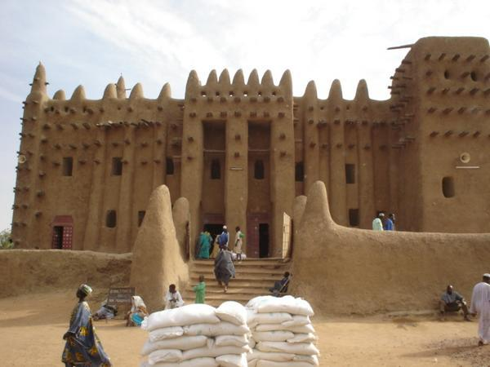
Mosque in Djenne, Mali (West Africa)
http://www.travelblog.org/Photos/17028.html
38

Slide 51
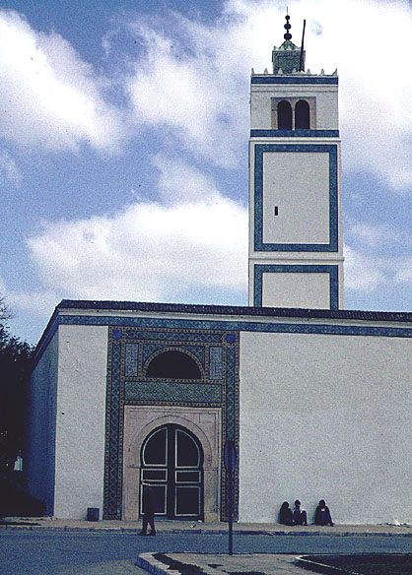
North African mosque
http://www.galenfrysinger.com/
tunis.htm 39

Slide 52
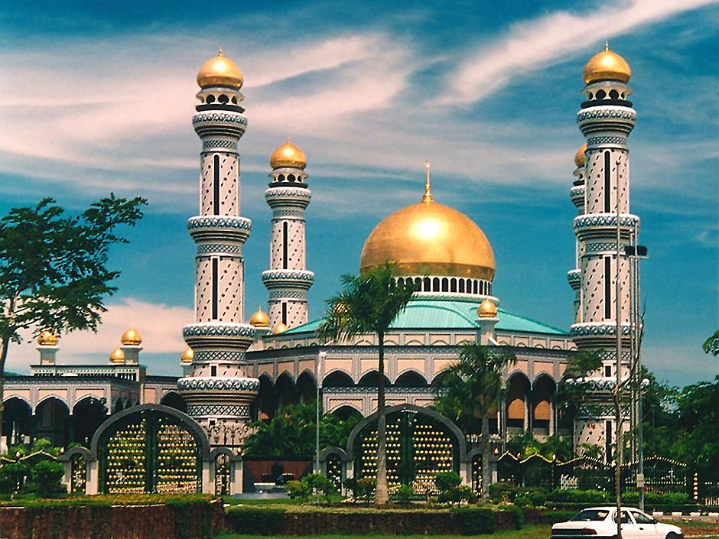
Indonesian mosque
http://www.richard-seaman.com/Travel/Brunei/index.html
40

Slide 53
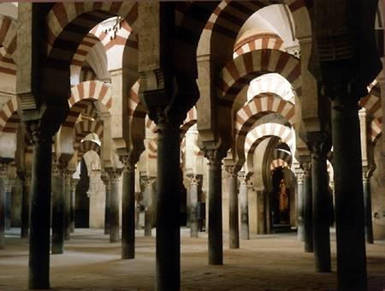
Islamic architecture in Spain
http://www.islamservices.org
41

Slide 54
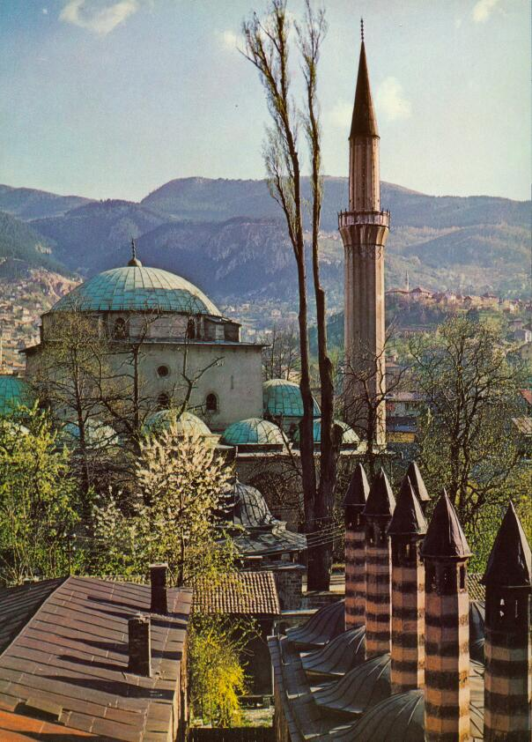
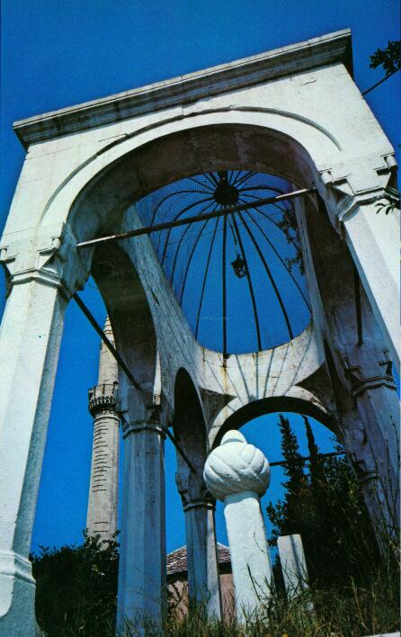
Muslim mosque and tombstone in Sarajevo, Bosnia
Yugoslavia: Republics and Provinces
42

Slide 55
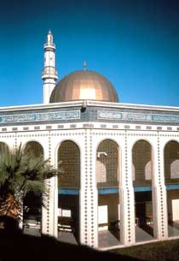
Mosque in Tempe, Arizona
http://www.4uth.gov.ua/usa/english/society/muslimlife/mosques.htm
43

Slide 56
Vocabulary:
QURAN (or KORAN): Muslim holy book
44

Slide 57
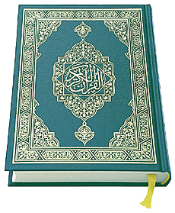
The Quran
http://www.minhajsisters.com/home/articles/index.minhaj?id=8
45

Slide 58
Muslim influences on
secular art
46

Slide 59
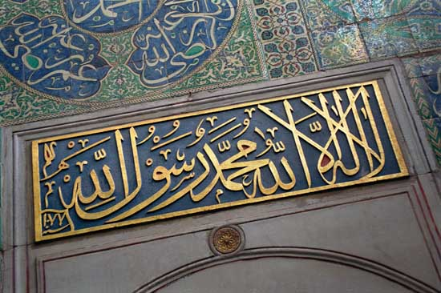
Muslim profession of faith in the Topkapi Palace, Istanbul, Turkey
http://www.britannica.com/eb/article-251804/Muhammad
47

Slide 60
Arabic calligraphy in secular art
http://www.plumsite.com/
palace/arabic.html
49

Slide 61
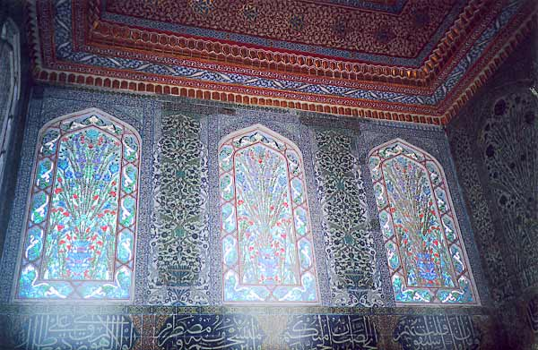
Stained glass windows in the Topkapi Palace in Istanbul, Turkey
http://www.geocities.com/mlafren/english/turk.html
48

Slide 62
Conclusions:
Islam is an important religion, which shares many beliefs and practices with Christianity and Judaism.
Muslims live in many different countries. Islam is especially widespread in Africa, Asia, and southeastern Europe (the Balkans).
Islam has had a great impact on world art and culture.
50

