Slide 1
Writing the Argumentative Essay
AP Government and Politics

Slide 2
Warm-Up
Consider the following prompt:
Develop an argument that explains whether term limits for members of Congress would be beneficial or harmful.
Individually, brainstorm your answer to the above prompt, considering the following required documents:
Federalist No. 51
The Constitution

Slide 3
Full Prompt
Develop an argument that explains whether term limits for members of Congress would be beneficial or harmful. In your essay, you must:
Articulate a defensible claim or thesis that responds to the prompt and establishes a line of reasoning.
Support your claim with at least TWO pieces of accurate and relevant information: At least ONE piece of evidence must be from one of the following foundational documents: Federalist 51 and the United States Constitution.
Use a second piece of evidence from a document from the list above or from your study of Congress
Use reasoning to explain why your evidence supports your claim/thesis
Respond to an opposing or alternative perspective using refutation, concession or rebuttal

Slide 4
Key Terms*
Thesis – a claim or position on an issue or topic put forward and supported by evidence
Claim – a statement made about an issue that asserts a perspective
Evidence – information (data, quotations, excerpts) used as proof to support a claim or thesis
Line of reasoning – arrangement of claims and evidence that leads to a conclusion
Refutation – disproving an opposing perspective by providing counterclaims or counterevidence
Rebuttal – contradicting an opposing perspective by providing alternate, more convincing evidence
Perspective – a point of view conveyed through an argument.
*Source: AP Seminar Course and Exam Description

Slide 5
Full Prompt
Develop an argument that explains whether term limits for members of Congress would be beneficial or harmful. In your essay, you must:
Articulate a defensible claim or thesis that responds to the prompt and establishes a line of reasoning.
Support your claim with at least TWO pieces of accurate and relevant information: At least ONE piece of evidence must be from one of the following foundational documents: Federalist 51 and the United States Constitution.
Use a second piece of evidence from a document from the list above or from your study of Congress
Use reasoning to explain why your evidence supports your claim/thesis
Respond to an opposing or alternative perspective using refutation, concession or rebuttal

Slide 6
Summary and Response
Video: How to Conquer the FRQ Argument Essay for AP Government
During the Video: Take notes on both the PROCESS and the ANSWER to the question.
After the Video: Compare the answer with the answer you and your partner came up with to the FULL prompt

Slide 7
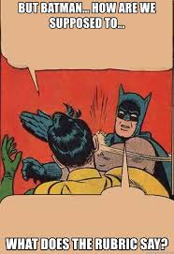
Rubric
A good response should:
Articulate a defensible claim or thesis that responds to the question and establishes a line of reasoning (0-1 point)
Describe one piece of evidence that is accurately linked to the topic of the question (the first of 3 points); use one piece of specific and relevant evidence to support the argument (the second of 3 points); use two pieces of specific and relevant evidence to support the argument (the third of 3 points)
Explain how or why the evidence supports the claim or thesis (0-1 point)
Respond to an opposing or alternate perspective using refutation, concession, or rebuttal that is consistent with the argument (0-1 point)

Slide 8
Key Points - Claims
Claim –
Not a fact, such as “The Constitution has a Bill or Rights”
Debatable point, something about which people may disagree
Example: “The federal government, state governments, and private companies should work together to provide healthcare.”
Refuting claims –
“I don’t agree with you” is not effective
Offer evidence and other reasoning to show WHY your position is stronger
Concede another viewpoint but emphasize WHY your position is stronger

Slide 9
Key Points - Evidence
Evidence
If you can explain how evidence relates to a claim, it is likely relevant
Facts alone do not demonstrate evidence: you have to EXPLAIN how it connects
Consider a line of reasoning (connecting claims and evidence)
Sources of evidence – textbook readings, supplemental work, class discussions, and documents (you MUST use at least ONE document)
Remember, good evidence strengthens your argument!

Slide 10
Review: Sample #2
Develop an argument that explains why the Bill of Rights needed to be added to the U.S. Constitution. In your essay you must do the following:
Articulate a defensible claim or thesis clearly stating your position
Support your claim with at least TWO pieces of accurate and relevant information: At least one of piece of information must be from one of the following foundational documents: (a) Declaration of Independence or (b) Brutus No. 1
Use a second piece of evidence from the other document in the list above or from your study of the nation’s constitutional foundation.
Use reasoning to organize and analyze evidence, explaining its significance to justify your claim or thesis.
Address opposing or alterative perspectives through refutation, concession, and rebuttal.

Slide 11
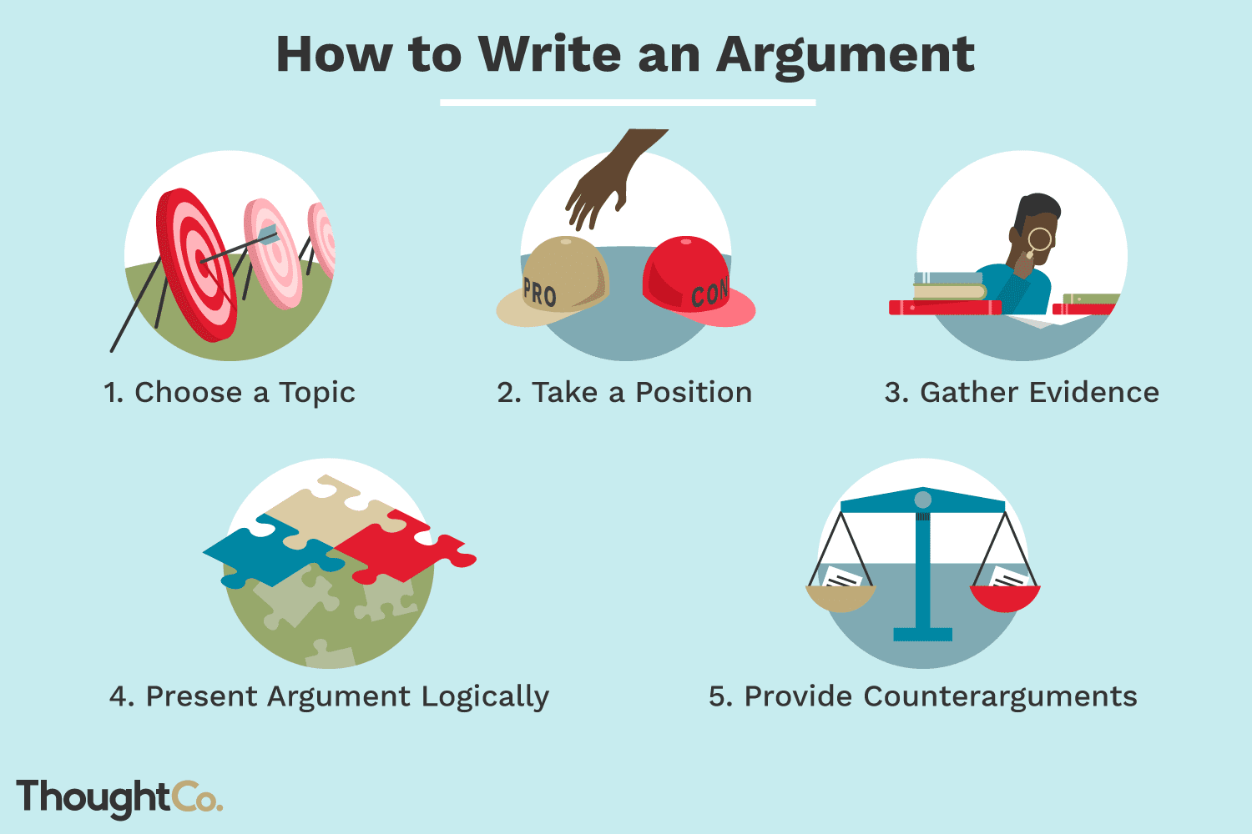
Review: Video Summary
Watch the following videos, take notes on key ideas, and write down questions that you have as you are watching:
Argumentation Essay Medium Video
Parts of an Argument: Claims, Counterclaims, Reasons and Evidence

Slide 12
Exit Ticket
Complete the following on your exit ticket for today:
Summarize three key points of writing the argumentative essay
Write down AT LEAST TWO questions that you still have about writing the argumentative essay
Be prepared to discuss your takeaways and questions at the beginning of class tomorrow. This conversation will begin our review for the test.

