Slide 1
Income Inequality: Minimum Wage & the Wage Gap
Poverty in America Jordan High School

Slide 2
Wage gap
Wage Gap: the difference between the earnings of men and women relative to the earnings of men
5 Key Points about the Gender Wage Gap
Earnings Difference
White Women – $0.79
Black Women – $0.69
Hispanic Women – $0.59
Causes of the Wage Gap
History
Sexism and Discrimination – mommy track, maternity leave
Glass Ceiling – limited opportunities
Others?

Slide 3
Wage gap
What People Miss About the Gender Wage Gap
With your partner, complete the following:
Read and annotate one of the following articles
The Gender Pay Gap is a Complete Myth (CBS News)
The Gender Pay Gap: Myth vs. Fact (National Organization of Women)
Discuss the arguments with your partner. You should be familiar with both articles.

Slide 4
Minimum wage - history
History
A Brief History of the U.S. Minimum Wage (ABC)
A History of the Minimum Wage (Time)
Early 1900s – Progressive Movement
FDR/New Deal: The Fair Labor Standards Act (1938) set national minimum wage of 0.25 an hour, 44 hour work week, and the elimination of child labor
1990s – “Living Wage Movement”

Slide 5
Minimum wage
Federal Minimum Wage Today ($7.25)
29 states (plus D.C) have a wage higher than fed min wage
Some cities have a higher minimum wage; some states have laws prohibiting cities and counties from setting a higher wage level
2,561,000 workers (or 3.3% of the hourly paid working population) earn the federal minimum wage or less.
Workers earning less include
Full time students who can be paid no less than 85% of the federal minimum wage
Workers with disability
New hires under the age of 20 who may be paid $4.25 for the first 90 days of employment
Tipped workers who may be paid less but whose cash tips must make up their take home to equal at least the minimum wage

Slide 6
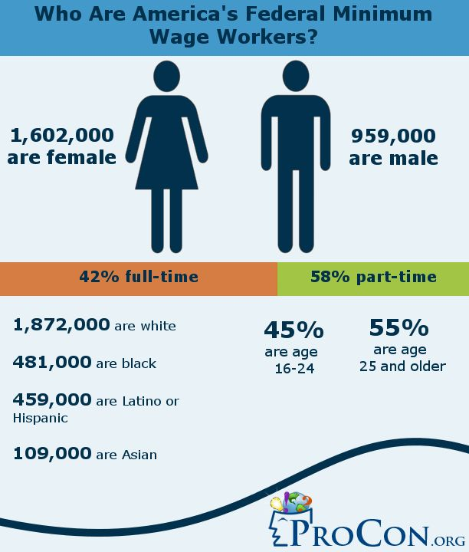
DiscussioN prompt:
Evaluate the information in the graph. What are three takeaways?

Slide 7
Debates – increase min wage?
Economic Activity and Job Growth
Reduce Poverty vs. Increase Poverty
Reduce spending vs. Hurt Businesses
Impact on inflation
Economic growth vs. Shift in workforce
Reduce income inequality vs. Low skill workers disadvantaged
Reduce racial/gender inequality vs. Reduce upward mobility
Raise other incomes vs. Increased automation
Increase productivity vs. Harm the poorest areas
Allow affordable housing vs. increased housing cost
Affordable everyday essentials vs. free market impact
Healthier population vs. decreased benefits/increased taxes
Increase vs. Decrease in school attendance
Reduce federal deficit vs. encouraging outsourcing
A reduction in crime?

Slide 8
Debates – increase min wage?
Does it help the poor?
Do Minimum Wage Increases Actually Help the Poor?
$15.00 an hour?
YES (Robert Reich, MoveOn.org) vs. NO (Learn Liberty)
How do you feel and why?

