Slide 1
Hispanic/Latinx: Data, Concepts & Subgroups
Multicultural Studies – Jordan High School

Slide 2
Language & Numbers
Identification/Language
Hispanic
Latino
Latinx
Second largest group in the United States today
More than 1 in 8 people in the US population are of Spanish or Latin American origin
The Census Bureau estimates that by the year 2100, Hispanics will constitute about 1/3rd of the US population

Slide 3
Key Terms & Concepts
Alien – non-citizen, documented or undocumented (12-14 million undocumented)
Borderlands – the area of common culture along the border between Mexico and the United States
Ethclass – the merging of ethnicity and class in a person’s status
Immigrant – person who comes to a country with the intention of permanent settlement
Panethnicity – group solidarity
Remittances – monies that immigrants return to their country of origin

Slide 4
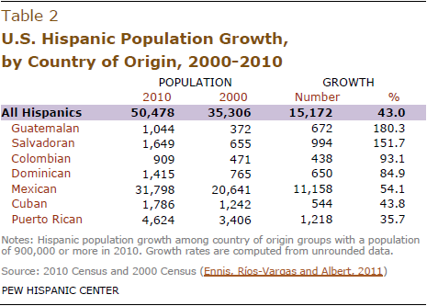

Slide 5
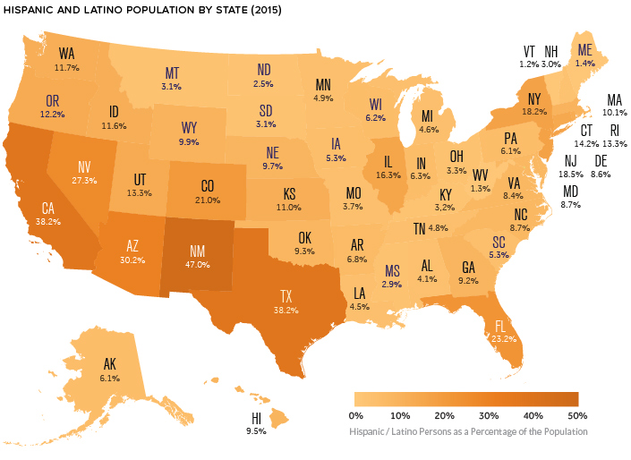

Slide 6
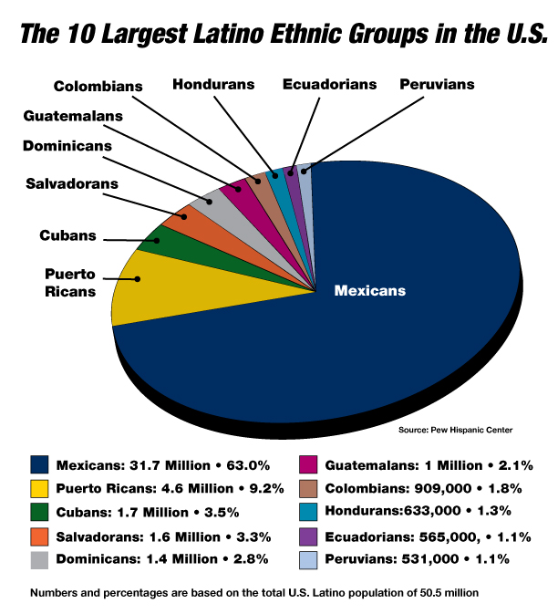

Slide 7
Cuban Americans
Three waves of immigration
First wave (1959-1962): Castro’s assumption of power to the Cuban Missile Crisis
Second wave (1965-1973): Special program of “freedom flights” between Havana to Miami
Most settled in Miami, creating ‘Little Havana’
Third wave (1980s): Marielitos – name given to the people forcibly deported by way of Mariel habor
Modern Issues
2000: Elian Gonzalez
George W. Bush vs. Barack Obama
Reflected in the film Sicko

Slide 8
Puerto Ricans
The United States acquired Puerto Rico as a result of the Spanish American war
Strategic location for maritime trade
Citizenship was extended to Puerto Ricans by the Jones Act of 1917 but they remained a colony (today are called a U.S. territory)
Economic challenges
World War II
Loss of manufacturing jobs
Recession of the 1970s and 1980s
Neoricans: Puerto Ricans who return to the island to settle after living on the mainland of the United States

Slide 9
Puerto Ricans
Issues of Statehood and Self-Rule
Territory: fear of higher taxes and erosion of cultural heritage
Statehood: full “citizenship status, ” key to increased economic development and expansion for tourism
Independence: regain cultural and political autonomy
Future status most recently faced a vote in 1998; in a nonbinding referendum
50% favored commonwealth status
47% supported statehood
3% favored complete independence

Slide 10
Puerto Ricans
Reasons for debt/economic decline (poverty rate is currently at 50%)
Population loss
Job crisis
Lenders enabled the island’s debt binge
Failed pension promises
Federal rules
Hurricane damage
Others?

Slide 11
Central/South Americans
Diverse population that has not been closely studied
People are described based on language and dialects, religious differences, urban vs. rural backgrounds, and color gradient (the placement of people on a continuum from light to dark skin color rather than in distinct racial subgroupings)
Immigration has been sporadic, influenced by our immigration laws and social forces
Modern issues: immigration status and brain drain, high unemployment

Slide 12
Mexican Americans
Historical context
19th Century: they were regarded as a conquered people as whites were already prejudiced against people of mixed blood
Mexican America War, 1846-1848
20th Century: a pattern of second-class treatment
Repatriation – the program during the 1930s of deporting Mexicans
Bracero Program: contracted Mexican laborers brought to the United States during World War II (ended in 1964)
La Raza: “The People,” a term referring to the rich heritage of Mexican Americans and therefore used to denote a sense of pride among Mexican Americans today

