Slide 1
edTPA Orientation
August 9, 2018

Slide 2
Key Takeaways from “Making Good Choices”
Key points: What are your key takeaways from reading “Making Good Choices”?
(After reading it, what is in your head next to “edTPA”)

Slide 3
Demystifying the edTPA: Burning Questions

Slide 4
Today’s Session:
We’ll address the
Who
What
When
Where
Why
(if not in that exact order)

Slide 5
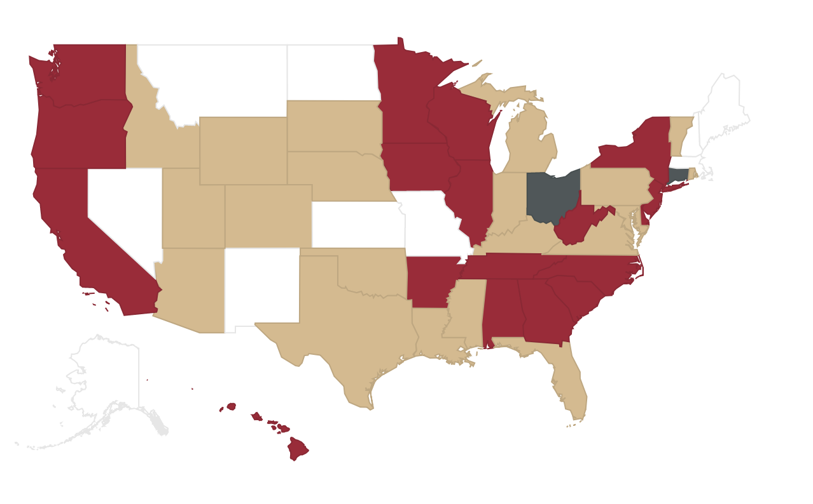
The Who Does It: Preservice teachers in 40 (and counting) states
edTPA is the “first and only nationally available, educator-designed, subject-specific performance assessment for beginning teachers.”
edTPA is in the implementation stage in North Carolina and will become a requirement for a North Carolina beginning teaching license in September 2019. It is an NC requirement for teacher preparation programs, including at Duke.
North Carolina is one of 40 states currently participating in edTPA.
Participation Map: http://edtpa.aacte.org/state-policy
The Duke MAT program joins 786 other Educator Preparation Programs in implementing the portfolio-based assessment.
Notes:
Not: Nevada, New Mexico, Montana, North Dakota, Missouri, Massachusetts, New Hampshire, Maine

Slide 6
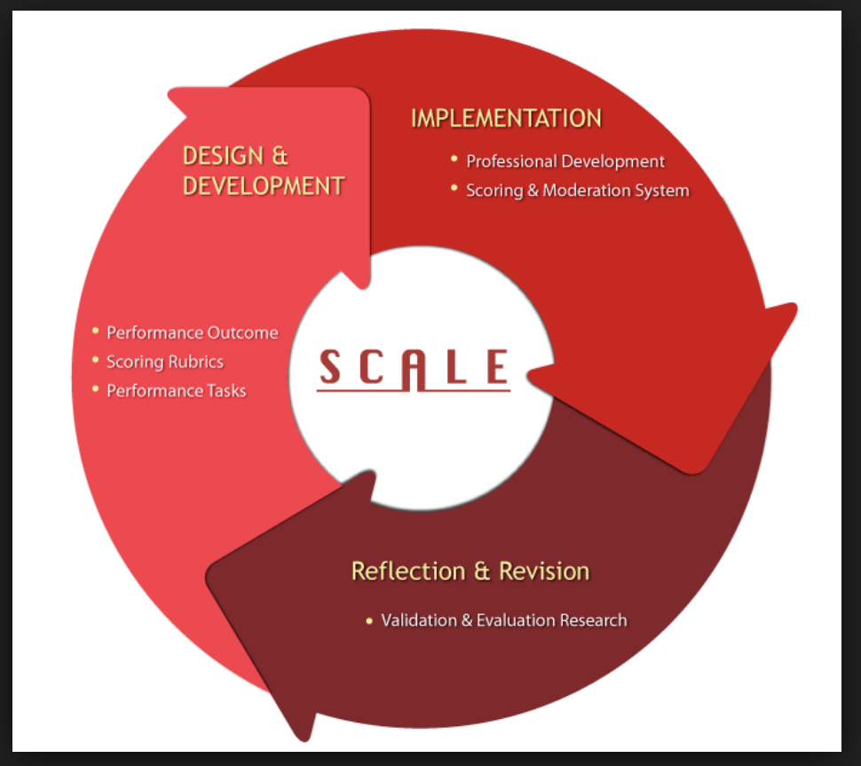
The Who Done It
edTPA was developed “for the profession, by the profession” by SCALE (Stanford Center for Assessment, Learning, and Equity) in 2009, and it was constructed with the broad involvement of professional educators.
edTPA was field tested in 2013 with more than 12,000 teacher candidates and has gone through multiple revisions.
Came from a response to legislation in CA.
Started off as a grassroots movement from faculty, who recruited teachers to create.
Pearson handles the official scores (but didn’t come from Pearson).
(Other option is PPAT from Praxis – created by testing company.)

Slide 7
The Why:
There used to be a different “portfolio” as part of educator preparation (each institution had it’s own portfolio that had to meet state requirements).
You’re not doing anything extra: edTPA is taking the place of a different project that wasn’t nationally normed.
Lots of similarity with National Board (modeled off of National Board Certification portfolio).

Slide 8
The good, the bad, and the corny (stay positive)
Pearson scorers are current or former (within past 5 years) teachers and educators who go through long and rigorous training; random checks of inter-rate reliability;
Program in Education will cover the cost of your edTPA;
It truly is about “effective teaching” in that it connects planning to instruction to assessment – gets at the heart of “how will you know if ALL students got it?”
edTPA forces you to think about how you’re impacting students;
It is scored by Pearson;
It costs $300;
It is a beast of an endeavor, requires a lot of time;
There are no shortcuts to reading the handbook and getting into the nitty gritty and just putting in the time.
Notes:
To be a

Slide 9
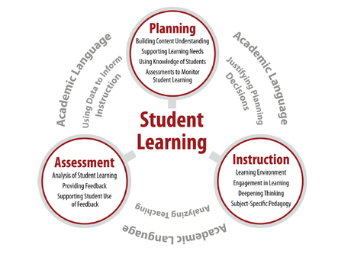
The What: the Big Picture
Task 1
Task 3
Task 2
Copyright © 2016 Board of Trustees of the Leland Stanford Junior University.

Slide 10
The WHAT it looks like
 | Artifacts | Commentaries/Templates
Task 1: Planning | Context for Learning Lesson Plans Additional Instructional Materials Blank Assessments | Planning Commentary
Task 2: Instruction | Video clips Supporting Documentation | Instruction Commentary
Task 3: Assessment | 3 student work samples Evaluation criteria for chosen assessment Optional: if feedback is not written on samples, audio or video file w/ optional transcription Optional: video for academic language requirement | Assessment Commentary

Slide 11
Task 1: Planning Stage of Teaching
Build students’ content understanding
Support students’ learning needs
Use knowledge of your students to plan effectively
Leverage assessments to monitor student learning
The artifacts and commentaries required for Task 1 include:
Context for learning (demographic information about the classroom and school community);
Lesson plans
Additional instructional materials
Blank assessments

Slide 12
Task 2: Instruction
Learning environment
Students’ engagement in learning
Deepening students’ thinking
Subject-specific pedagogy
The artifacts and commentaries required for Task 2 include:
Video Clips
Supporting documentation (e.g., if video is difficult to hear, you can include transcript)
Instruction commentary (commentary on video clips)

Slide 13
Task 3: Assessment
Analysis of student learning
(Doesn’t have to be summative assessment – formative works!)
Samples of feedback provided to students
Evidence of supporting students’ use of feedback
The artifacts and commentaries required for Task 3 include:
Three student work samples with feedback on the samples
Evaluation criteria for chosen assessment
Assessment commentary

Slide 14
Addressing Diverse Needs of Learners: Task 1 and Task 3
Task 1 throughout: Consider the variety of learners in your class who may require different strategies/support (e.g., students with IEPs or 504 plans, English language learners, struggling readers, underperforming students or those with gaps in academic knowledge, and/or gifted students).
Task 3: Select 3 student work samples to illustrate your analysis of patterns of learning within and across learners in the class. At least 1 of the samples must be from a student with specific learning needs.
These 3 students will be your focus students. Summarize the learning of the whole class, referring to work samples from the 3 focus students to illustrate patterns in student understanding across the class.

Slide 15
Importance of Academic Language
Academic language: the way you think and talk school – invisible thing that surrounds us when you enter school;
At each stage of edTPA you are being asked to consider academic language;
You can’t assume when students walk in the classroom that they know what comparing/contrasting means;
Teach specific strategies to your students to help them be able to access and use academic language (e.g., analyze, compare /contrast, etc.);
“Describe” in English and “describe” in science – might be different language and syntax;
How to write in different content areas;

Slide 16
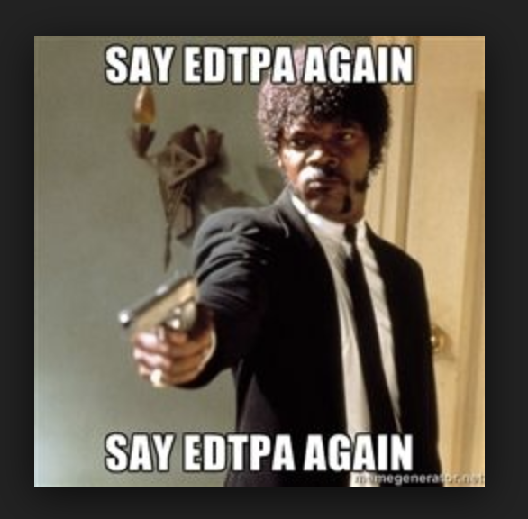
The HOW
You pick ONE CLASS and design a learning segment of 3-5 consecutive LESSONS for that class.
You write lesson plans, you video record yourself teaching those lessons, and you collect assessment data during the lessons.
At each stage, you reflect and write about what you did.

Slide 17
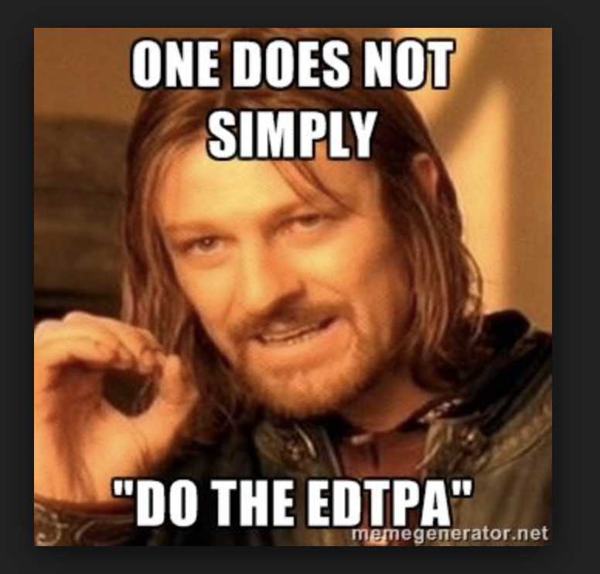
Learning Segment
A learning segment is a part of a unit connected by standards and objectives, a central focus, and academic language demands (a “snapshot”)
3 - 5 consecutive lessons that are approximately 3 - 5 hours of instruction FOR ONE CLASS.
You can use the MAT lesson plan template (there’s not an edTPA lesson plan template)

Slide 18
How it is scored:
5 rubrics per task = 15 rubrics
Each is scored on a scale of 1-5
3 is proficient
Possible total score of 75
Two or more condition codes in one task = no score for edTPA
Two readers from Pearson
Three weeks to get your scores back

Slide 19
Target Score and Why
Target score: 40 (it’s what NC is considering for it’s target score)
edTPA policy by state:
https://secure.aacte.org/apps/rl/res_get.php?fid=1014&ref=edtpa
If you might teach in another state: look up what their “cut” score is (if they have one)
https://www.edtpa.com/PageView.aspx?f=GEN_StateRequirements.html
If you don’t get a 40 or above…

Slide 20
As per NC legislation passed in Fall 2017, if you receive a 48 or above on the edTPA and have an undergraduate GPA of 3.75 or higher, you qualify for a bonus as a “Highly Qualified NC Teaching Graduate”
A highly qualified graduate is paid a monthly supplement of the equivalent of the difference in salary of a Bachelor level teacher with zero years of experience and
3 years of experience, if teaching in a low performing school for the first 3 years of employment.
2 years of experience, if licensed and teaching in EC, science, technology, engineering or mathematics for the first 2 years of employment.
1 year of experience, for all others for the first year of employment.

Slide 21
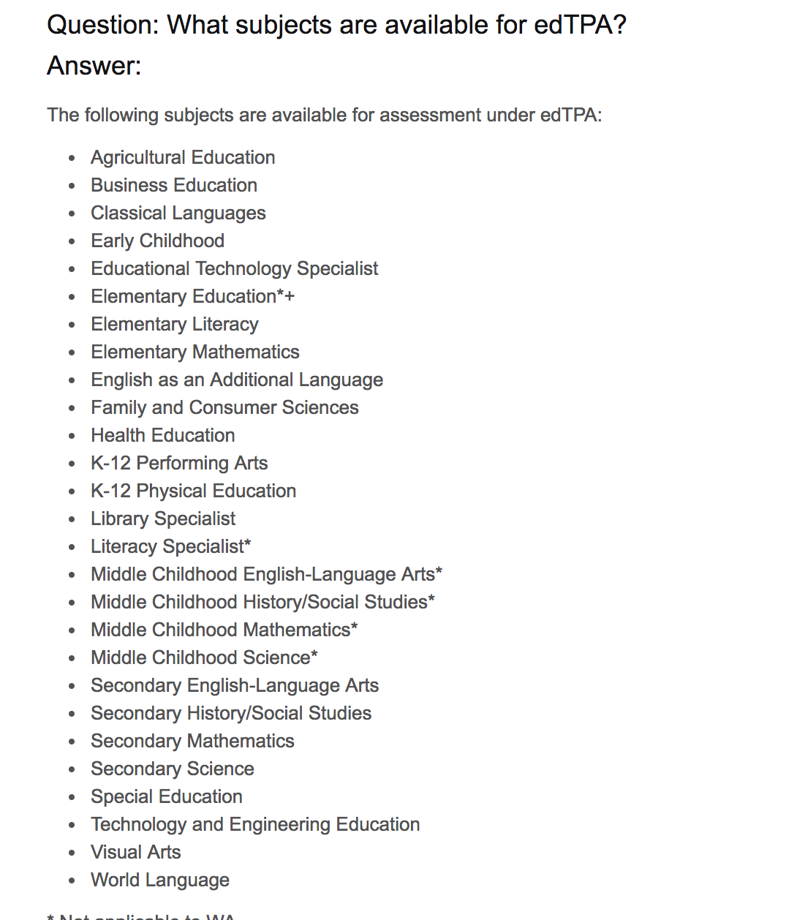
edTPA has 27 different subjects /assessments
Handbooks for each subject area (50-ish pages and different rubrics depending on subjects)
Notes:
* Not applicable to WA.

Slide 22
The When and Where
Submission date: drop dead date: January 31 to Pearson
Internal deadline: we’ll submit in class on Wednesday, January 23 (receive voucher then, time required for technical components – submit to Chalk and Wire and transfer to Pearson)
You’ll collect artifacts/ record, etc. from ONE CLASS from your first semester internship
We’ll spend four sessions in MAT 743 in the fall on edTPA (one more with Carlo, two will involve reviewing portfolios from Class of 2018, one with SAMS talking about academic language)

Slide 23
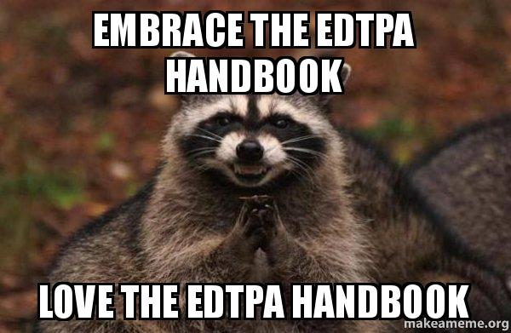
BIG assignment for September 5
Read and annotate your handbook
Create one-pager

Slide 24
edTPA resources on: MAT Wordpress site and edTPA site
https://sites.duke.edu/matprogram/edtpa/
Video permissions (share with your mentor teacher – you want them ready to go for day one)
Templates
Handbooks
Videotaping guidelines
Academic language
http://www.edtpa.com/Home.aspx
Duke library has resources for editing video
We have iPads if you want to check them out

Slide 25
A few other thoughts:
Video permission slips! First thing to think about / take care of at the start of your student teaching.
Your mentor teacher may know a little or not much about edTPA but many have been through NBCT
Proprietary nature of materials: have to be password protected (Duke Wordpress site)
Plan in advance to video A LOT more than you’ll need
Think small, specific, focused for lessons

Slide 26
Questions

