Slide 2
Gifted Students in Advanced Placement Programs
October 18, 2016 - Beth Cross, Advanced Academics

Slide 3
Gifted Identification in DPS
Academically and Intellectually Gifted (AIG)
Nationally-normed aptitude 90%ile and above
and at least one of the following:
Nationally-Normed Achievement test 90%ile
and/or EOG 85%ile or grade 90%/Level 4
Intellectually Gifted (IG)
Nationally-normed aptitude =
96 %ile and above
Academically Gifted (AG)
Nationally-normed achievement = 90%ile and above and
EOG 85%ile or grade 90%/Level 4
Notes:
DPS conducts a “sweep screen” of students in third and sixth grades. Nomination by teacher, parent, student or peer will also result in gathering data or testing.
● DPS uses multiple measures to identify students which include all of the following: aptitude, achievement, performance (grades), gifted behavior checklists/teacher observations.
● Data used in identification nominations are grades, teacher observations, student interests/activities, etc.
● DPS has policies in place to safeguard the rights of AIG students and parents as well as procedures for resolving disagreements.
● DPS documents all identification of and services for AIG students through Differentiated Education Plans (DEP).

Slide 4
North Carolina Definition of Giftedness
“Academically or intellectually gifted students” exhibit high performance capability in intellectual areas, specific academic fields, or in both intellectual areas and specific academic fields. Academically or intellectually gifted students require differentiated educational services beyond those ordinarily provided by the regular educational program. Outstanding abilities are present in students from all cultural groups, across all economic strata, and in all areas of human endeavor. (North Carolina. Gen. Stat. § 115C-150.5)

Slide 5
Advanced Placement

Slide 6
Four Myths of AP Courses
AP courses are about memorization and do not require students to think critically.
High school teachers lack expertise to teach college-level classes.
Awarding college credit reduces chances for wider intellectual exploration in college.
College courses provide greater intellectual breadth and depth than AP classes.

Slide 7
8 Benefits of AP Courses for Gifted Learners
1. Acceleration
Improved motivation, scholarship, and confidence of gifted and talented students over time;
Prevention of habits of mental laziness;
Earlier access to and completion of more advanced opportunities; and
Reduction of the total cost of college education and time toward a degree and professional preparation.

Slide 8
Benefits of AP Courses for Gifted Learners
College-level work in HS “net”
Core knowledge used by professionals
Advanced concepts
AP exam for credit
Additional “weight”
Challenge, quality of instruction, and learning environment they need
Emphasis on critical thinking

Slide 9
Focus of AP Courses
Experience
Exploration
Awareness
Discovery
Creativity
…should receive the most focus, not the credit earned.

Slide 10
Teaching Models for Differentiation
Concept Development Model
Problem-Based Learning
Paul Reasoning Model
Research model
Socratic Seminar

Slide 11
Teaching Strategies for Gifted Learners in AP Classes
Preassessment and Diagnostic follow-up
In-class power tasks
Specific feedback for student improvement
Targeted homework
Tutorial review and test practices (6 weeks)
Taking the AP exam

Slide 12
Targeted Strategies
Analyzing Primary Sources
Developing Research Skills
Targeted Thinking Skills
Thinking is complex- made up of many skills
Thinking is dependent on student discourse
Thinking is integrated and interrelated
Thinking is an inquiring mind as well as mastery of skills
Thinking is best taught in context of content
Reasoning through a situation or event
Paul’s Reasoning Model

Slide 13
Characteristics of an Issue for Research
Real world
Multiple points of view
Researchable and substantial information available
Worthy topic and personal involvement
Linked to Reasoning Model

Slide 14
Research: Issue Versus Topic
Topic
Issue
Pollution
Bio-diesel fuel conversion
Vietnam War
Thomas Jefferson
What policy changes need to be made to protect U.S. citizens from pollution?
Is bio-diesel a cost-efficient alternative?
Was the Vietnam War worth fighting?
What are the implications and consequences of Thomas Jefferson’s contributions on life today?

Slide 15
8 Questions for Students Elements of Reasoning
What is the main purpose of the reasoning?
What are the key issues, problems, and questions being addressed?
What is the most important information being used?
What main inferences are embedded in the reasoning?
What are the key concepts guiding the reasoning?
What assumptions are being used?
What are the positive and negative implications?
What point of view is/should be represented?

Slide 16
Elements of Reasoning Character
What is the main purpose of the character?
What are the key issues and problems facing the character?
What is the most significant information the character uses in his or her reasoning?
What main inferences or judgments are made by the character?
What key concepts guide the character’s reasoning?
What main assumptions guide the behavior of the character?
What are the most important implications of the character’s thinking and behavior?
What is the main point of view of the character? Does that point of view change during the story? If so, how?

Slide 17
Targeted Thinking Skills
Mathematics
Looking for patterns, systems, logical inferences
Making a model
Setting up an equation
Mathematical modeling based on assumptions
Science
Selecting problem or issue
Study the problems
Making hypotheses
Collecting, analyzing and interpreting data
Drawing conclusions
Making implications
Literature
Interpreting and creating analogies
Using inductive and deductive reasoning
Making inferences
Discerning author’s purpose or point of view
Evaluating arguments

Slide 18
80%

Slide 19
Historically, state and national surveys indicate that approximately 80% of the questions K-12th grade students are exposed to are lower-level questions.

Slide 20
In college, this trend reverses and students are asked to deal
primarily with
high-level critical questions.

Slide 21
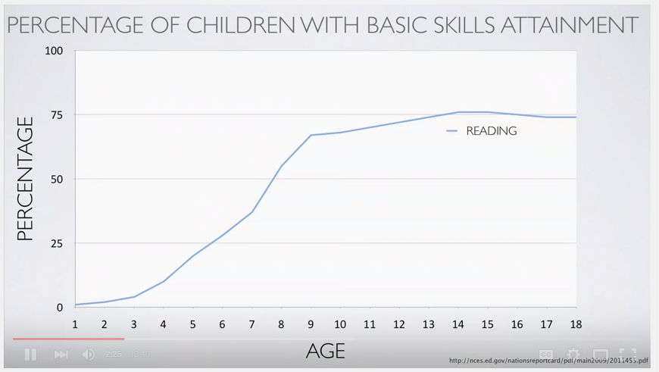

Slide 22
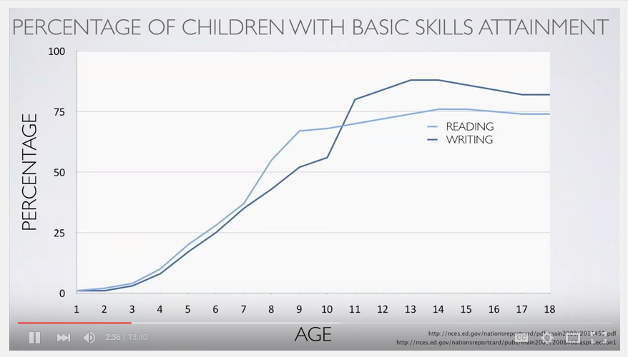

Slide 23
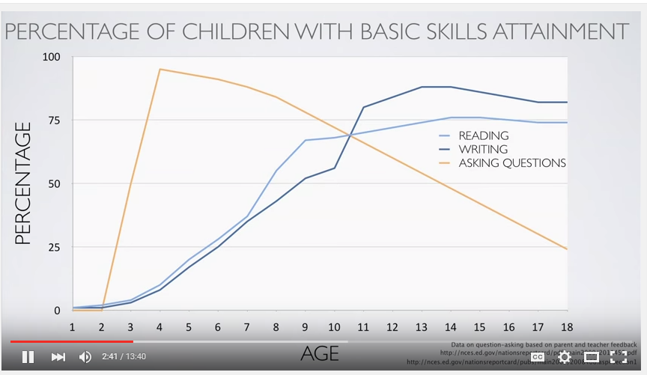

Slide 24
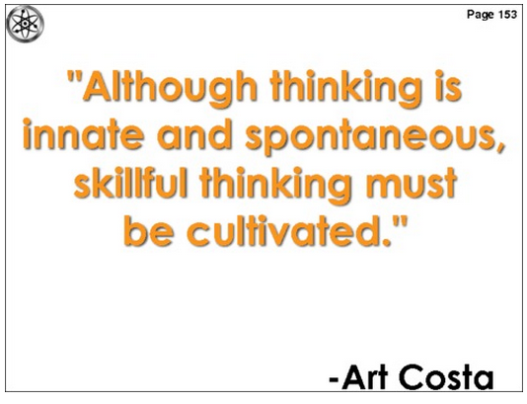

Slide 25
Levels of Questioning
Creating: Can the student create a new product or point of view? | assemble, construct, create, design, develop, formulate, write
Evaluating: Can the student justify a stand or decision? | appraise, argue, defend, judge, select, support, value, evaluate
Analyzing: Can the student distinguish between the different parts? | appraise, compare, contrast, criticize, differentiate, discriminate, distinguish, examine, experiment, question, test
Applying: Can the student use the information in a new way? | choose, demonstrate, dramatize, employ, illustrate, interpret, operate, schedule, sketch, solve, use, write
Understanding: Can the student explain ideas or concepts? | classify, describe, discuss, explain, identify, locate, recognize, report, select, translate, paraphrase
Remembering: Can the student recall or remember the information? | define, duplicate, list, memorize, recall, repeat, reproduce state

Slide 26
Levels of Questioning
Creating: Can the student create a new product or point of view? | assemble, construct, create, design, develop, formulate, write
Evaluating: Can the student justify a stand or decision? | appraise, argue, defend, judge, select, support, value, evaluate
Analyzing: Can the student distinguish between the different parts? | appraise, compare, contrast, criticize, differentiate, discriminate, distinguish, examine, experiment, question, test
Applying: Can the student use the information in a new way? | choose, demonstrate, dramatize, employ, illustrate, interpret, operate, schedule, sketch, solve, use, write
Understanding: Can the student explain ideas or concepts? | classify, describe, discuss, explain, identify, locate, recognize, report, select, translate, paraphrase
Remembering: Can the student recall or remember the information? | define, duplicate, list, memorize, recall, repeat, reproduce state

Slide 27
Example: AP World History

Slide 28
Questions?

