Slide 1
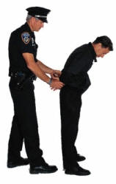
Criminal Procedure Process

Slide 2
Basic Courtroom Vocabulary
Probable Cause: what the prosecution must have to get a warrant for investigation.
Plea Bargain: negotiation btw the prosecution and the defense to avoid long & expensive trial and may get a lighter sentence.
Prosecution might make a deal to reduce the sentence if the suspect pleads guilty and/or if he testifies against others.
Can take place at any time right up to jury returning a verdict.
Perjury: lying under oath
Subpoena: written legal order directing a person to testify in court or provide records

Slide 3
Basic Courtroom Vocabulary
Contempt of Court: If a person is interfering with the judicial process, the judge will declare the person in “contempt of court.”
“Burden of Proof:” It is the prosecution’s job to prove that the defendant is guilty “beyond a reasonable doubt.”
Hung Jury: When the jury cannot reach a unanimous verdict →Mistrial
Bench Trial: When a person chooses to have a judge, instead of a jury, hear the case.

Slide 4
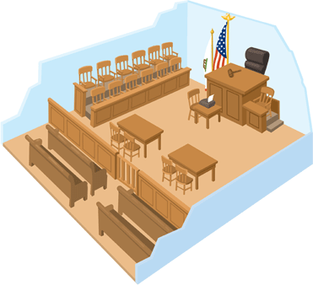
Courtroom Layout

Slide 5
Steps of a Criminal Trial (A.P.I.A.T.S.)
A rrest
P reliminary hearing
I ndictment
A rraignment
T rial
S entencing

Slide 6
How I can remember APIATS?
Always Play In A
Toy Store

Slide 7
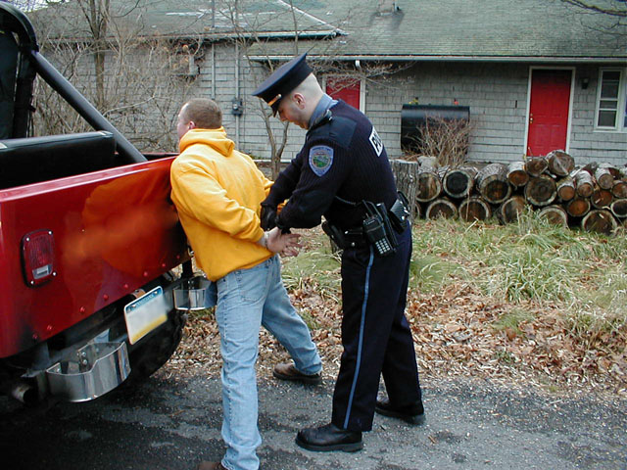
Step 1: Arrest
Probable cause and warrant (unless caught in the act – no warrant needed)

Slide 8
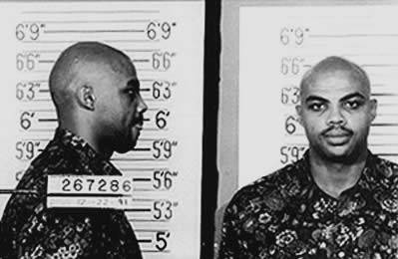
Step 1: Arrest
Getting “booked”
Photograph, fingerprint, phone call

Slide 9
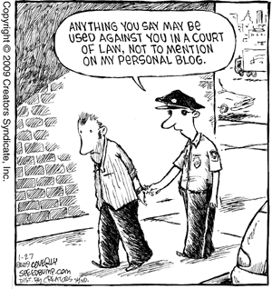
Step 1: Arrest
Arrested suspect must be read Miranda rights before being interrogated.

Slide 10
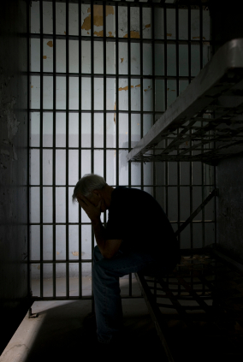
Step 1: Arrest
Suspect can be held up to 48-72 hours (depends on state) before preliminary hearing.

Slide 11
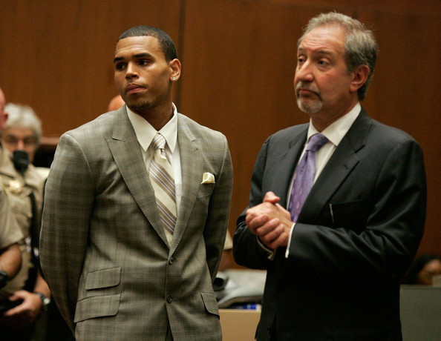
Step 2: Preliminary Hearing
Suspect appears before judge & is told of crime accused of.
Prosecutor presents evidence to judge, who decides if there is enough to proceed with case.

Slide 12
Step 2: Preliminary Hearing
Court will appoint public defender if suspect can’t afford one.

Slide 13
Step 2: Preliminary Hearing
Judge can deny bail
Recognizance: for minor offenses → suspect released, agrees to appear in court when called.
What is the purpose of bail & how does it work?

Slide 14
Step 3: Indictment
A “grand jury” (16-23 people) hear evidence against a suspect and determine whether there is enough evidence to proceed to trial.
Used in NC, but not used in all states (the Preliminary Hearing takes the place of the Indictment in some states)
Used only for felonies (serious crimes)
Decides whether to indict (a formal charge) suspect.

Slide 15
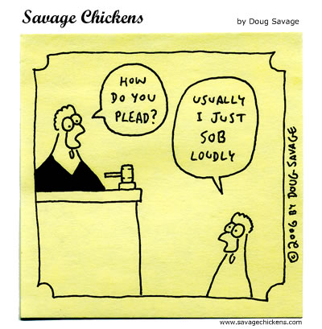
Step 4: Arraignment
Hearing in which suspect pleads:
Not Guilty (trial)
Not Guilty by reason of insanity (trial)
Guilty (judge assigns punishment)
No Contest (nolo contendere) (judge assigns punishment)

Slide 16
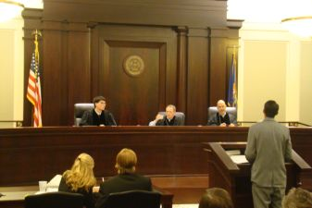
Step 5: Trial
Pretrial Motions - Lawyers might try to get judge to dismiss evidence, witnesses, change location of the trial…

Slide 17
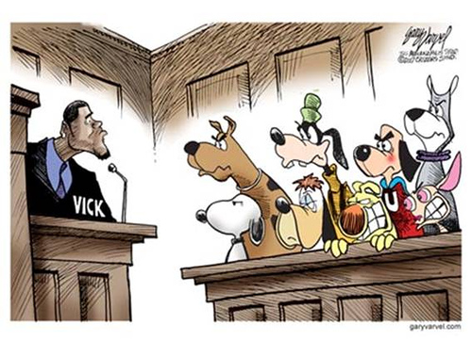
Step 5: Trial
Jury Selection (“voire dire”) Each side’s lawyers interview possible jury members; can exclude people from jury
DO NOW! While listening to the following video, identify following:
Goals in this process
Examples of people who cannot serve as a juror
How a “peremptory challenge” works
Process of selecting a jury
http://www.youtube.com/watch?v=z8V0CgCYsFI

Slide 18
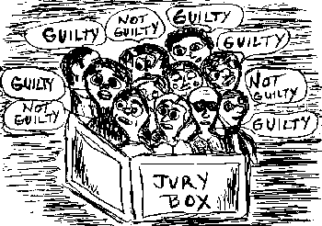
Step 6: Sentencing
If guilty, judge sets court date for sentencing.
Jury often recommends sentence, but judge usually has final say.

Slide 19
Step 5: Trial
Opening Statements - defense goes last
NC State Mock Trial Championship Round at 4:50
Direct Examination – witnesses give testimony (statements made under oath)
NC State Mock Trial Championship Round at 15:40 (Direct of Prosecution Witness)
Cross Examination – other side can question witnesses to try to cast doubt on truth and reliability of witness
NC State Mock Trial Championship Round at 22:20 (Cross of Prosecution Witness)

Slide 20
Step 5: Trial
Closing Arguments
NC State Mock Trial Championship Round at 25 seconds
http://www.youtube.com/watch?v=XMi_H_Iu9hY
Jury Deliberation – jury discusses & comes to a verdict: guilty (convict), not guilty (acquit), or “hung jury” (mistrial)
Verdict must be unanimous! → In NC, 12-0
If mistrial, prosecution must decide whether to drop charges or ask for retrial

Slide 21
Step 6: Sentencing
Penal Code ~ Statutes that spell out the punishments that go with each crime.
Judges often have a little leeway in imposing sentences and can consider mitigating circumstances – factors surrounding the crime.
Mandatory Sentencing ~ Laws which require judges to impose whatever sentence the law directs.
Commute a Sentence ~ to reduce a sentence.

Slide 22
Step 6: Sentencing
Three Strikes Rule ~ A person convicted of 3 felonies may never receive parole (in jail for life).
Parole ~ conditional early release from jail.
Parolees must meet certain conditions:
Meet regularly with parole officer.
May not associate with certain types of people.
No gambling or alcohol.

Slide 23
Methods of Punishment
Incarceration (Prison/Jail)
Probation
Fines
Community Service
Mental Institution
Boot Camp
Death Penalty
Injunction ~ court order commanding person to stop an action.

Slide 24
4 Goals of Punishment
Rehabilitation ~ enable those who commit crimes to enter society again.
Retribution ~ punishment for a crime.
Restitution ~ money damages for committing a crime.
Deterrence ~ preventing crime through punishment.
Recidivism ~ the habitual relapse into criminal behavior.

Slide 25
Criminal Lawsuits
Plaintiff/Prosecution ~ state or federal government
VERSUS
Defendant ~ person being accused of a crime.

Slide 26
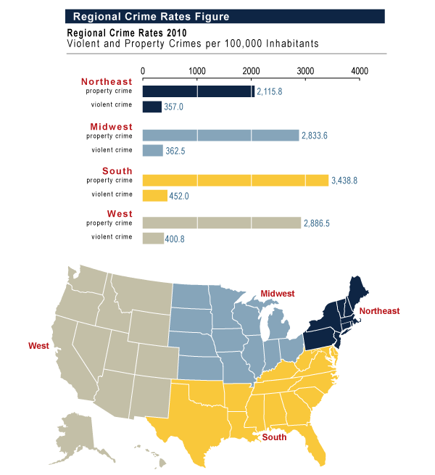

Slide 27
Types of Crimes
Misdemeanors ~ minors crimes with a fine or prison sentence of one year or less.
Felonies ~ serious crimes with prison sentence for more than one year.

Slide 28
Further Break-Down of Crimes
Crimes against People
Murder, Manslaughter, Assault, Rape, Robbery and Kidnapping.
Crimes against Property
Burglary, Theft, Vandalism, Arson, Forgery, and Fraud.
Crimes against Morality
Illegal use of drugs, unauthorized gambling.

Slide 29
3 Types of Larceny
Larceny ~ the taking of property unlawfully.
Burglary ~ breaking and entering into another’s property with intent of committing a crime.
Robbery ~ taking property from another by force or threat of force.
Theft ~ taking property (without force)
Examples: Shoplifting, stealing hubcaps

Slide 30
Juvenile Justice System

Slide 31
Juveniles
Juveniles ~ anyone under the age of 18 is considered to be a “juvenile”.
Juvenile Delinquent ~ a juvenile who has committed a crime.
Juveniles who are more likely to become delinquents:
Suffer abuse or neglect,
Suffer emotional or mental problems
Poverty – over crowded neighborhoods where drug and alcohol abuse are common.

Slide 32
Purpose of the Juvenile Court
Primary Goal ~ to rehabilitate or correct a young person’s behavior
Main Principle ~ Do whatever is in the best interest of the child.

Slide 33
Rules for Handling Juveniles
Police must notify juvenile’s parents of arrest.
Juveniles do NOT have the right to jury trials.
Judges attempt to keep proceedings and the identity of juveniles secret.
Juveniles may be tried as an adult if crime is extreme.

Slide 34
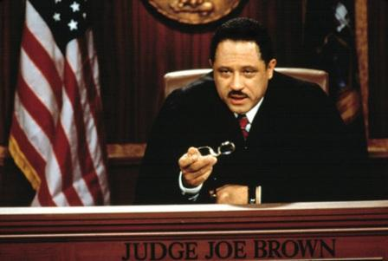
Civil Law

Slide 35
Civil Lawsuits
Plaintiff ~ party bringing the lawsuit claiming that a loss has occurred and demanding damages
VERSUS
Defendant ~ party being sued argues that they are not responsible for the damage or loss

Slide 36
What are the Steps in a Civil Case?
Hire a lawyer.
Plaintiff’s lawyer files a complaint.
Court sends the defendant a summons to appear in court at a given date and time.
Defendant responds to the charges by filing an answer to the complaint.
Discovery phase.
Plaintiff & then Defendant present their sides of the case in court.
Court issues a verdict.

Slide 37
Most Civil Cases are Resolved before Trial for these Reasons:
Outcomes at trial are hard to predict so negotiated settlements give some predictability in the case.
Most courts have a backlog of civil cases meaning it could be years waiting on a trial.
Trials and legal assistance is so expensive that both sides likely want to end the spending.

Slide 38
Conflict Resolution

Slide 39
Conflict Resolution
~ different ways in which parties can resolve conflict without a trial.
Compromise
each side gives in a little to reach an acceptable resolution.
Consensus Building
reaching an agreement by starting with the things that can be agreed on and building from there.

Slide 40
Conflict Resolution
Negotiation
Process of bargaining to achieve an outcome that benefits all parties.
Arbitration & Mediation
Using a neutral third party to hear a dispute and suggest a resolution.

