Slide 1
Causes and Measurement of American Poverty

Slide 2
Causes of Poverty
Institutional
Economic
Environmental
Activity – In small groups, explain five examples that fall under each main cause above

Slide 3
Institutional
Social Stratification – A set of social and economic institutions that generate inequality and power; a focus on income inequality
Institutional Racism
American Justice System
Discrimination in the Workforce
Educational Inequity
AIG – Impact of the 3rd Grade
“Every child gets an education”

Slide 4
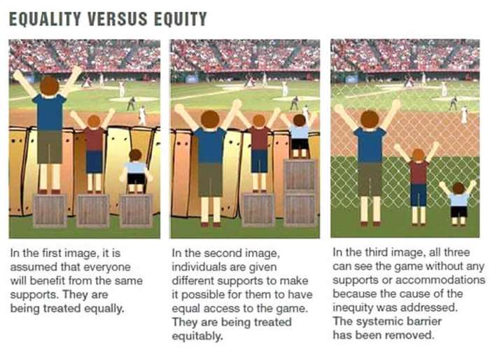

Slide 5
Think about this…
Minority groups are more likely than whites to have low levels of education, lower levels of employment, lower wages, and have chronic health problems
Economic growth determines the size of the pie, while inequality affects the size of each slice. What does this mean?

Slide 6
Economic
Unemployment/Job Loss
Homelessness
Predatory Lending
Debt and Interest
Recession and/or Depression
Lack of skills (hard and soft skills)
Lack of financial literacy
Culture of Poverty
Obstacles and additional costs
Lack of economic growth

Slide 7
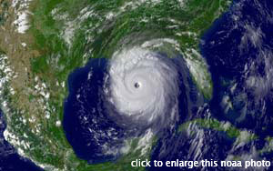
Environmental
200,000 people homeless
800,000 people without power
2,500 people missing or dead
$81.2 billion dollars in damages
Looting, violence, and riots
Variety of health problems
Environmental effects
Communication failures
Racial and class tensions
Infrastructure destroyed
Case Study: Hurricane Katrina

Slide 8
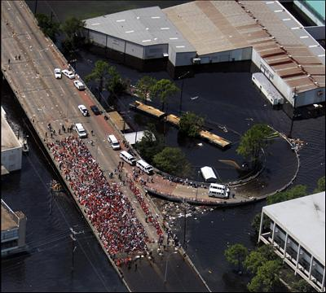
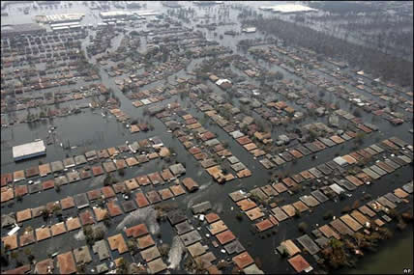

Slide 9
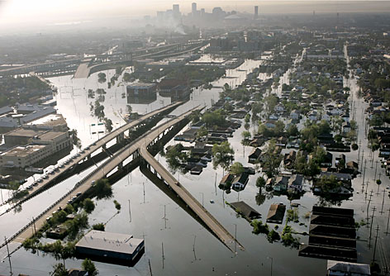
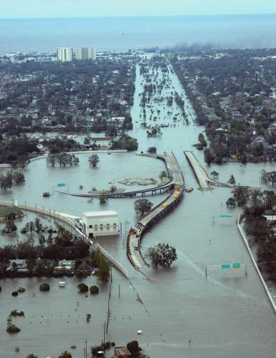

Slide 10
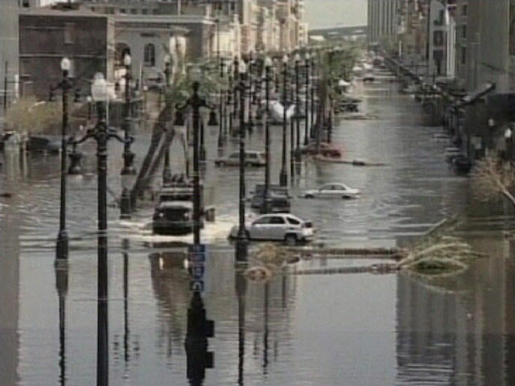

Slide 11
Measuring Poverty
Absolute measures, such as the current US official measure, typically attempt to define a truly basic – absolute – needs standard (remains constant over time)
Advantages?
Disadvantages?

Slide 12
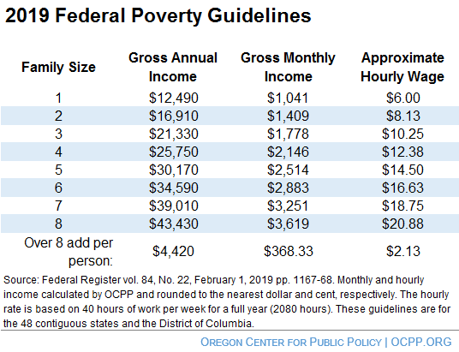
Measuring Poverty

Slide 13
Measuring Poverty
Relative measures, more commonly used by researchers and policy makers in Europe
Advantages?
Disadvantages?

Slide 14
Measuring Poverty
Other Measurements:
Consumption Measures – Compare not a family’s income but rather its consumption of goods to a poverty threshold; can be absolute or relative (if a family spends little, they have little)
Self-Reliance – measures “earnings capacity; indicates or reflects the capability of families to meet the minimum level of living

Slide 15
Measuring Poverty
Other Measurements:
Hardship measures are based on respondents reporting a lack of food, heat, access to, or adequate housing (no consensus on what exactly to measure)
4. Social exclusion – “a short-hand term for what can happen when people or areas suffer from a combination of linked problems such as unemployment, poor skills, low income, poor housing, high crime environment, bad health and family breakdown”;

Slide 16
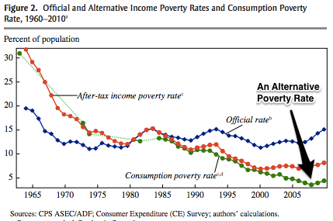

Slide 17
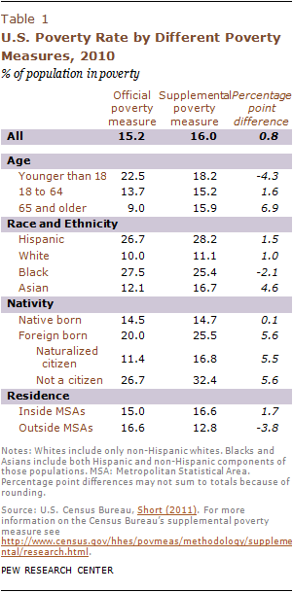
Measuring Poverty

Slide 18
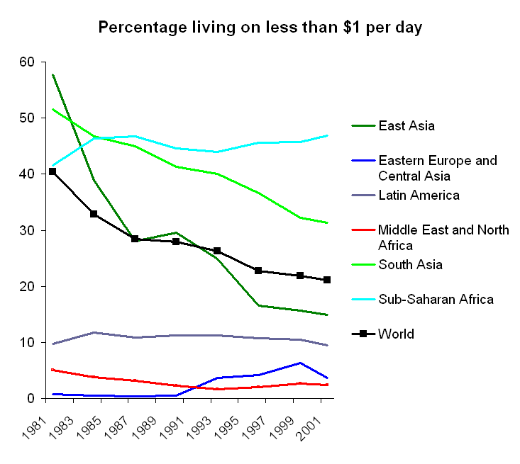
Measuring Poverty

Slide 19
Measuring Poverty
National Research Council of the National Academy of Sciences (NAS):
1995 report: “Measuring Poverty: A New Approach”
Poverty measure is “relative” in nature
Recommendation: Quasi-relative approach based on a range of possible values based on budgets, poverty thresholds, census data, etc. rather than on a dollar amount
Strengths? Weaknesses?

