Slide 1

21st Century Skills in the Classroom

Slide 2
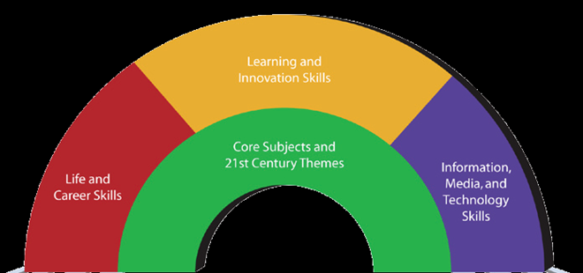
21st Century Skills Framework
Core Content and Outcomes
Support Systems
www.p21.org

Slide 3
Elements of 21st Century Learning
21st Century Themes
Global Awareness
Financial, Economic, Business and Entrepreneurial Literacy
Civic Literacy
Health Literacy
Environmental Literacy

Slide 4
Global Awareness
  BRINGING THE OUTSIDE WORLD INTO THE CLASSROOM
Using 21st century skills to understand and address global issues.
Learning from and working collaboratively with individuals representing diverse cultures, religions and lifestyles in a spirit of mutual respect and open dialogue in personal, work and community contexts.
Having the ability to utilize non-English languages as a tool for understanding other nations and cultures.

Slide 5
Financial, Economic, Business & Entrepreneurial Literacy
  YOU HAVE TO GIVE SOMETHING TO GET SOMETHING
Knowing how to make appropriate personal economic choices.
Understanding the role of the economy and the role of business in the economy.
Using entrepreneurial skills to enhance workplace productivity and career options.

Slide 6
Civic Literacy
  WE ARE PART OF A DEMOCRACY AND WE HAVE A VOICE
Being an informed citizen to participate effectively in government.
Exercising the rights and obligations of citizenship at local, state, national and global levels.
Understanding the local and global implications of civic decisions.

Slide 7
Health Literacy
  THE DECISIONS WE MAKE ON HOW WE TAKE CARE OF OURSELVES, IMPACT EVERY ASPECT OF OUR LIVES
Having the ability to access health information and services, navigate health institutions and act as an effective advocate to improve health for self, family and/or community.
Understanding preventive physical and mental health measures, including proper diet, nutrition, exercise, risk avoidance and stress reduction.
Demonstrating understanding of national and international health.

Slide 8
Environmental Literacy
????

Slide 9
Environmental Literacy
  WE USE RESOURCES AND RESOURCES ARE LIMITED
  WE CREATE WASTE AND WASTE TAKES SPACE

Slide 10
Elements of 21st Century Learning

Slide 11
Life and Career Skills
Leadership
Ethics
Accountability
Flexibility and Adaptability
Personal Productivity
Personal Responsibility
People Skills
Initiative and Self-direction
Social and Cross-Cultural Skills

Slide 12
Life and Career Skills
Leadership
  Using interpersonal and problem-solving skills to influence more than one person toward a goal.
  Having the ability to leverage strengths of others to accomplish a common goal.
Ethics
  Demonstrating integrity and ethical behavior in personal, workplace and community contexts.
Accountability
  Setting and meeting high standards and goals for one’s self and others.

Slide 13
Life and Career Skills Continued
Adaptability
  Adapting to varied roles and responsibilities.
  Tolerating ambiguity and changing priorities.
Productivity
  Utilizing time efficiently and manage workload.
  Being punctual and reliable.
Personal Responsibility
  Exercising personal responsibility and flexibility in personal, workplace and community contexts.

Slide 14
Life and Career Skills Continued
People Skills
  Working appropriately and productively with others.
Self Direction
  Monitoring one’s own understanding and learning needs.
  Demonstrating initiative to advance professional skill levels.
  Having the ability to define, prioritize and complete tasks without direct oversight.
  Demonstrating commitment to learning as a lifelong process.
Social Responsibility
  Acting responsibly with the interests of the larger community in mind.

Slide 15
Elements of 21st Century Learning
Critical Thinking and Problem Solving
Communication
Creativity and Innovation Skills
Collaboration Skills
Contextual Learning Skills

Slide 16
Learning and Innovation Skills
Critical Thinking and Problem Solving
  Exercising sound reasoning in understanding.
  Making complex choices.
  Understanding the interconnections among systems.
  Framing, analyzing and solving problems.
Communication
  Articulating thoughts and ideas clearly and effectively.
Creativity and Innovation Skills
  Demonstrating originality and inventiveness in work.
  Developing, implementing and communicating new ideas to others.
  Being open and responsive to new and diverse perspectives.

Slide 17
Learning and Innovation Skills Continued
Collaboration Skills
  Demonstrating ability to work effectively with diverse teams.
  Being willing to be helpful and make necessary compromises to accomplish a common goal.
Contextual Learning Skills
  Having the ability to take advantage of education in a variety of contexts both inside and outside the classroom; understanding that knowledge is acquired within a context.

Slide 18
Elements of 21st Century Learning
Information Literacy
Media Literacy
ICT (Information, Communications and Technology) Literacy

Slide 19
Information, Media & Technology Skills
Information and Media Literacy Skills
  Understanding, managing and creating effective oral, written and/or multimedia communication in a variety of forms and contexts.
  Analyzing, accessing, managing, integrating, evaluating and creating information in a variety of forms and media.
ICT Literacy (Information, Communications and Technology)
  Using technology in the course of attaining and utilizing 21st century skills.

Slide 20
Contact Information
Cheryl Fuller: cfuller62@nc.rr.com
919-971-6068

